Slide 1
The role of Aggregators and VPPs for Ancillary Services
Etem Erten, Technical Advisor
NARUC International Department
April 23, 2024
Neum, BIH

Slide 2
Presentation Outline
The larger context – electric industry transition
Drivers and impacts of DER growth
Aggregation of DER into virtual resources (VPPs)
Role of VPPs in providing ancillary services
Best practices on New flexibility products

Slide 3
Major Transformation characterized by:
Transitioning from traditional fossil fuels to sustainable but intermittent energy sources across all levels.
A surge in the integration of a wide array of decentralized energy options (e.g., energy communities, microgrids, off grid homes)
Electrification of transportation, heating, and other large energy uses
Decline of the traditional centralized, one-way power flow paradigm and associated revenue models and rate structures
New operational challenges to manage high DER penetration (especially DSOs)

Slide 4
DER growth is driven by:
Governments adopt climate action plans, seek to boost local economy, extend renewable energy and electrification
Development in new technologies and innovations make DERs feasible & economic
Customers want clean and low-cost energy, and resilience to disturbances
EU energy crises and high prices made renewables more attractive

Slide 5
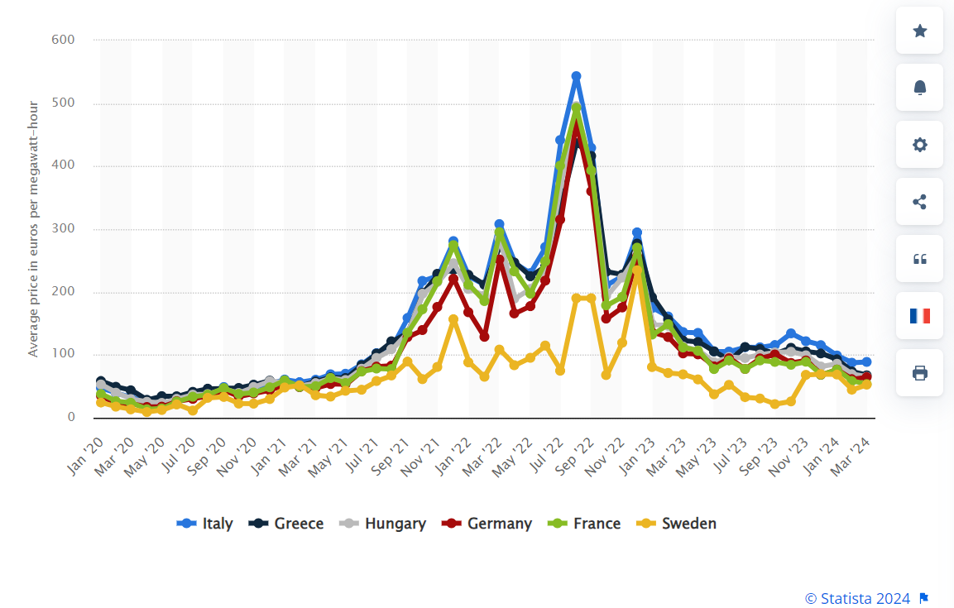
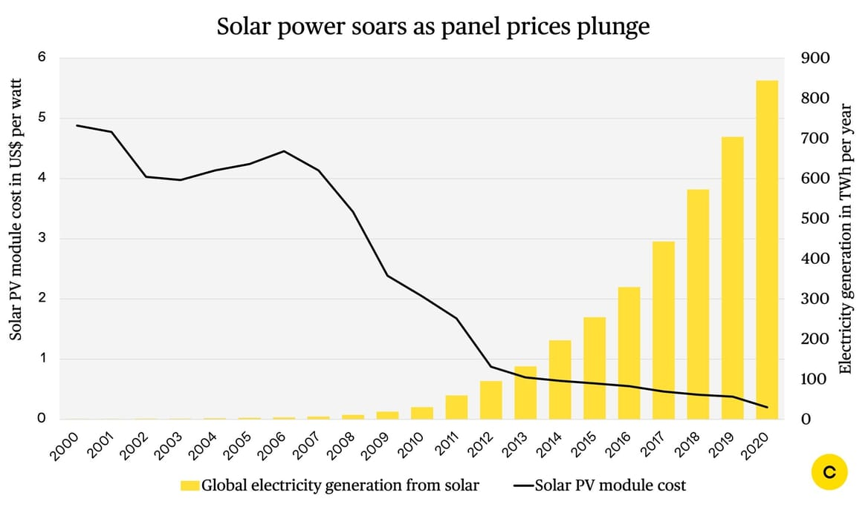
EU Energy Crisis
Other Implications Going Forward:

Slide 6
Role of Electrification
Expected demand growth for UK
Source: Modo Energy - How local flexibility markets for electricity work

Slide 7
The New Paradigm – Long Term
Bottom-up autonomous adoption => less top-down control
Potential for low-cost, resilient islanding; possible “grid defection”
Potential for transactive peer-to-peer markets at the grid edge
Flexibility products IN, pure kWhs OUT

Slide 8
Terminology
“DER” = all energy resources connected at distribution level, on customer side or utility side of the customer meter.
“A Virtual Power Plant (VPP)” is a virtual system asset that aggregates the capacities of various distributed energy resources (like wind turbines, solar panels, energy storage systems, and DR) and operates them as a single power plant.

Slide 9
Terminology
Directive (EU) 2019/944 defines ‘aggregation’ and 'independent aggregator’ as, respectively:
a function performed by a natural or legal person who combines multiple customer loads or generated electricity for sale, purchase or auction in any electricity market;
a market participant engaged in aggregation who is not affiliated to the customer's supplier.

Slide 10
DER -- What are we talking about?
DER: devices capable of producing power and connected to the distribution system or behind a customer meter. E.g.:
Rooftop and small utility solar, combined heat and power, small hydro, non-wires alternatives, peak shavers & back-up units
For PJM: excludes load reduction and energy efficiency
WHOLESALE—participates in wholesale markets. E.g.:
Small dedicated solar, landfill gas, and batteries
Wholesale demand response
WIRED WITH LOAD—DER wired with load behind a load meter (commonly referred to as “behind the meter”).
FTM—“Front of meter” gen and storage: DER studied for injections by PJM and sells injections into wholesale market.
DR—PJM Demand Response from DER: offsets in load at a customer from generators and batteries that are wired with load.
Non-wholesale—DER w/ no explicit participation in wholesale markets.
“SELL EXCESS”—DER wired w/ load selling excess energy at wholesale.
PURPA—DER selling output directly to interconnected utility under state-administered avoided-cost rate. No interaction with PJM.
WHOLESALE
WIRED WITH LOAD
FTM
DR
NON WHOLESALE
SELL EXCESS
PURPA
Notes:
The words on this slide are not meant to be read – meant to indication complication
DER is complicated. Especially in the context of the markets interacting with retail load. because, generally speaking, markets and TSOs not geared towards dealing with tiny resources that interconnect at distribution voltages
There is a lot of nuance when you say “DER”. Is it wholesale, is it retail, is it both? Is it in front of the meter or behind the meter? If behind the meter, will it inject megawatts and does it want to sell those injection at wholesale? Can it be both generation and load (storage)? And so on…

Slide 11
Challenges and opportunities
New challenges for distribution operations, planning & interconnection
Multi-directional, reversible flows on the distribution system
Substantial local supply to meet local demand
Long interconnection queues
Congestion at the distribution level
DER is in a position to not only provide services to customers, but also the networks (DSO and TSO systems)

Slide 12
DERs target revenues at multiple levels of the system.
Transmission system & wholesale market
DAM and IDM, balancing market, ancillary services market
Resource adequacy capacity (capacity markets or remuneration mechanisms)
Non-wires alternatives to transmission upgrades
Distribution system services
Deferral of new infrastructure (non-wires alternatives)
Operational services – voltage, power quality
Behind the end-use customer meter
Time of day load shifting, demand charge management, storage of excess solar generation
Service resilience – smart buildings, microgrids, critical loads
Bilateral energy contracts with customers
Citizen and Renewable energy communities

Slide 13
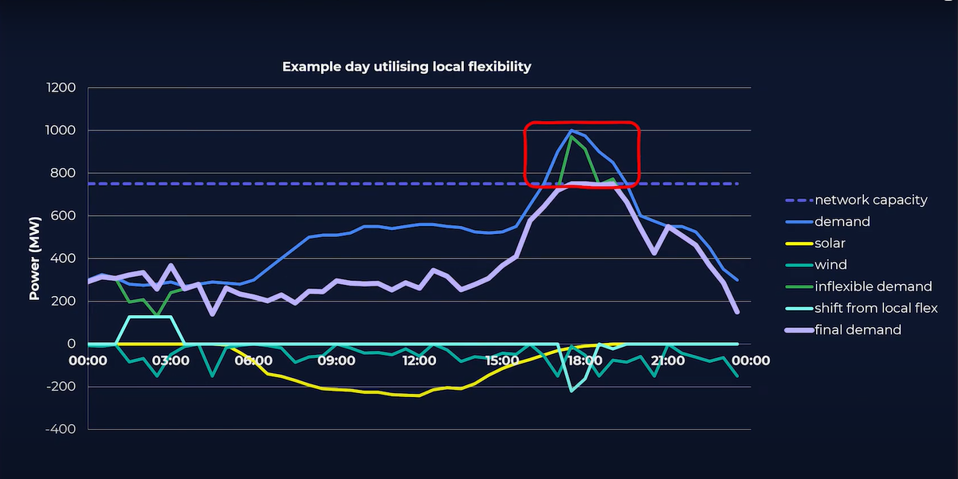
DER developers/adopters seek to provide services and earn revenues at multiple levels of the system.
“DER” = all energy resources connected at distribution level, on customer side or utility side of the customer meter
Plus communications & controls to aggregate & optimize DER
Behind the end-use customer meter
Time of day load shifting, demand charge management, storage of excess solar generation
Service resilience – smart buildings, microgrids, critical loads
Distribution system services
Deferral of new infrastructure
Operational services – voltage, power quality
Transmission system & wholesale market
DAM and IDM, reserves, ancillary services
Resource adequacy capacity
Non-wires alternatives to transmission upgrades
Bilateral energy contracts with customers
Citizen and Renewable energy communities
Source: Modo Energy - How local flexibility markets for electricity work

Slide 14
Major Requirements for Utilization of DERs for System Services
Main requirement is to establish markets for products and/or regulatory remuneration through tariffs
Flexibility Product definitions suitable for DER
System-wide products (wholesale markets and TSO)
Location-specific products (non-wires alternatives and DSOs)
Generally procured through tenders but also
Platforms are emerging as a business model (UK)
Interaction between the system-wide products and DSOs
Data collection and control (Digitalization)
Aggregators and relevant technological solutions
Integration of the IT systems of Aggregators and system operators (TSO, DSO)

Slide 15
Integration of the IT systems of Aggregators and system operators (TSO, DSO)
Upgrades needed at the system operator side to establish Distributed Energy Resource Management systems (DERMS)

Slide 16
Ancillary services for frequency stabilization

Slide 17
DER capabilities for balancing services
Solar power plants and wind farms have the technical capabilities to respond quickly to a control signal that regulates the required power level.
Down regulation is easier and less costly than up regulation
Reliability of the service is not always guaranteed
BESS, thanks to the inherent fast active power response and power gradient, is can fully meet the requirements for FCR.
Wind turbines can be capable to provide synthetic inertia to respond to rapid changes in power and frequency in the power system (faster than up/down regulation)
Reliability of the service is not always guaranteed

Slide 18
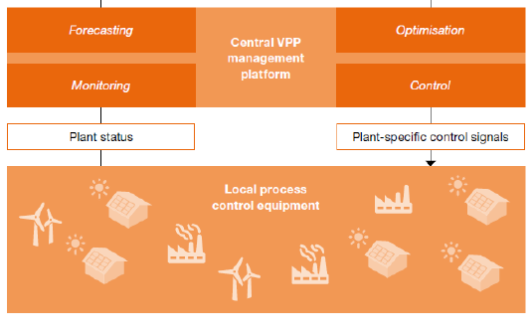
DER capabilities for balancing services
Aggregation helps to develop a more reliable response characteristics
A group of resources perform better by just pooling the resources (monitoring and forecasting)
Aggregators can/would also impose control over assets to manipulate the output (optimization and control)
VPPs can improve performance through addition of back up generators to the mix
Source: Price Waterhouse Cooper

Slide 19
DER capabilities for other ancillary services
Voltage regulation services are provided in a timescale of few seconds. The distributed generators are generally capable of meeting the requirements for service providers prescribed by the relevant system operators.
Generator “black start” services (switching on without an external power supply) can also be provided by DERs

Slide 20
What can be done further?
Updating existing products and procurement methods to provide more opportunities for the participation of DERs
Balancing capacity vs balancing energy auctions
Diversification of the frequency regulation product for separate directions rather than symmetric procurement
Upward regulation
Downward regulation
Decreasing minimum supply thresholds (currently FCR 1 MW, FRR 5 MW)
Definition of new products taking into account the specific services DERs can provide
New products for fast ramping and frequency response for BESS (battery energy storage systems) [FCR equivalent]
New products for synthetic intertia service from wind turbines
New products for voltage regulation by PVs

Slide 21
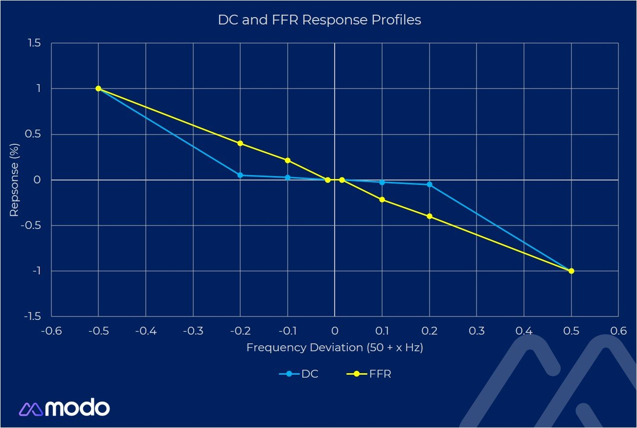
Specific Products - UK
Dynamic containment reserves
Fast response product (part of FCR)
Suitable for batteries
Can be both to response low and high-frequency deviations
Post-fault services (react to the frequency defaults)
Procured through daily auctions in the UK by the electricity system operator (ESO)
ESO moved the product to an automated auction platform in 2021

Slide 22
Specific Products - Congestion management
The German product:
Flexible bids are entered into the local bid registers, along with information about the service provider's grid location.
Bids are available to network operators (Avacon Netz, EWE NETZ and TenneT) who can use them to avoid and resolve network congestions.
EPEX SPOT acts as a neutral intermediary between the system operator and the service provider.

Slide 23
Specific Products - Congestion management
The UK product:
Product is similar to the German product
Flexible bids are entered into the platform, along with information about the service provider's grid location.
Bids are available to SO who can use them to avoid and resolve network congestions.
The platform is composed of a series of functional modules which SOs can subscribe to, based on flexibility needs and the required degree of process automation.
Piclo acts as a neutral intermediary between the system operator and the service provider.

Slide 24
FERCs approach
Notice of Proposed Rulemaking (NOPR) Proposes to require ISOs and RTOs to
Define DER aggregators as a type of market participant than can participate in the organized wholesale electric markets under the participation model that best accommodates the physical and operational characteristics of its DER aggregation
Establish a storage participation model that, recognizing physical and operational characteristics of electric storage resources, accommodates their participation in organized wholesale markets

Slide 25
NGR is CAISO’s BESS participation model
Non-Generator Resource (NGR)
Designed for a resource that can move seamlessly between consuming and injecting energy at different times
Market optimization manages storage characteristics including state of charge (SOC), maximum charge amount (limit on total energy it can provide), maximum charge and discharge rates
Resource can choose to have ISO manage SOC, or manage itself
Can be used by transmission-connected and distribution-connected resources
Can interconnect to ISO grid under our normal interconnection procedures – as a generator with negative output
Can provide regulation and other ancillary services
Visible to ISO and settled 24x7 (comparable to a generator)
Does not use baselines to measure performance

Slide 26
DERP is a market participant that aggregates DER
Distributed Energy Resource Provider (DERP)[Aggregator]
Executes DERP agreement with ISO, may create multiple DER aggregations (DERAs)[VPPs], each containing different sub-resources
A DERA [VPP] may mix DER types, as long as resource performance characteristics can be modeled in ISO market system
DERA and sub-resources are all directly metered: no baselines
Sub-resources of a DERA [VPP] must all be within a single sub-load aggregation point (due to nodal pricing)
Minimum DERA size is 0.5 MW;
Individual sub-resources must be less than 1.0 MW

Slide 27
Demand Response participates using the PDR model
Proxy Demand Resource (PDR)
Accommodates traditional load curtailment and behind-the-meter (BTM) devices such as energy storage
May be metered at load meter as traditional DR or via sub-metering of BTM devices to measure performance
In all cases, DR performance is calculated against a baseline
DR cannot inject energy into the grid (only load modification)
Currently, can only be dispatched to reduce demand
Not a 24x7 resource; only available when bid per program or resource availability parameters
Expected Future PDR enhancements:
Dispatch to increase consumption;

Slide 28
Resources
USAID EPA Report: Virtual power plants Report on international practice
https://usaideia.ba/wp-content/uploads/2021/11/2.-Report-on-International-Practice_Virtual-Power-Plants_5-4-20-English-Final.pdf
CAISO Process and requirements for DERs
https://www.caiso.com/participate/Pages/DistributedEnergyResourceProvider/Default.aspx#:~:text=Distributed%20energy%20resource%20providers%20are,participate%20in%20the%20wholesale%20market.
EpexSpot LocalFlex
https://www.epexspot.com/sites/default/files/download_center_files/20220616_4%20Flexibility.pdf
Piclo Flex
https://www.piclo.energy/flex

Slide 29
Thank you for your attention!

