Slide 1
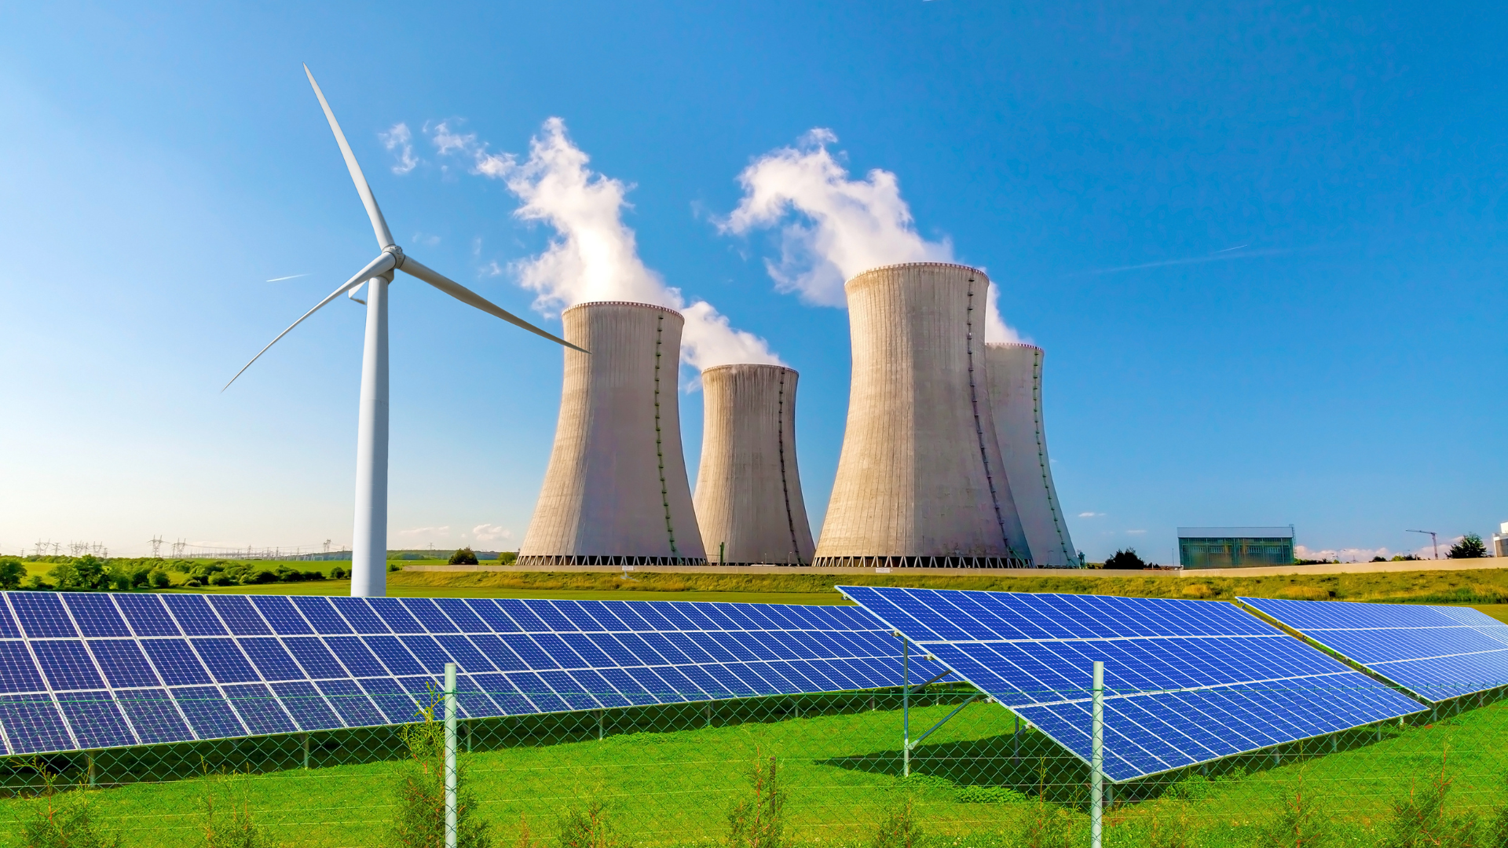
How Bosna and Herzegovina prepares for CBAM
Mr. Admir Softic, Assistant Minister, Ministry of Foreign Trade and Economic Relations of Bosnia and Herzegovina

Slide 2
TABLE OF CONTENTS
1
IMPLICATION OF CBAM ON BIH ECONOMY
2
WHAT BIH HAS TO DO FOR CBAM UNTIL 2026?
3
WHAT BIH COMPANIES MUST DO UNTIL 2026 ?

Slide 3
IMPLICATION OF CBAM ON BIH ECONOMY
Optimal scenario - Applied ETS factors, CBAM price aligned with EU ETS, and applied exemption for electricity
Period 2026-2030 for all industries | Optimal scenario
Loss of income, BAM in millions | 2.186,51
Loss of quantity, kg in millions | 2.079,61
Loss of quantity, MWh in millions | 0,00
Job loss, employee | 418
Collected through CBAM, BAM in millions | 379,14
Collected thorugh ETS, BAM in millions | 290,59
Collected ETS+CBAM for electricity, BAM in millions | 0,00
ETS
CBAM
KM 290 mil
KM 380 mil

Slide 4
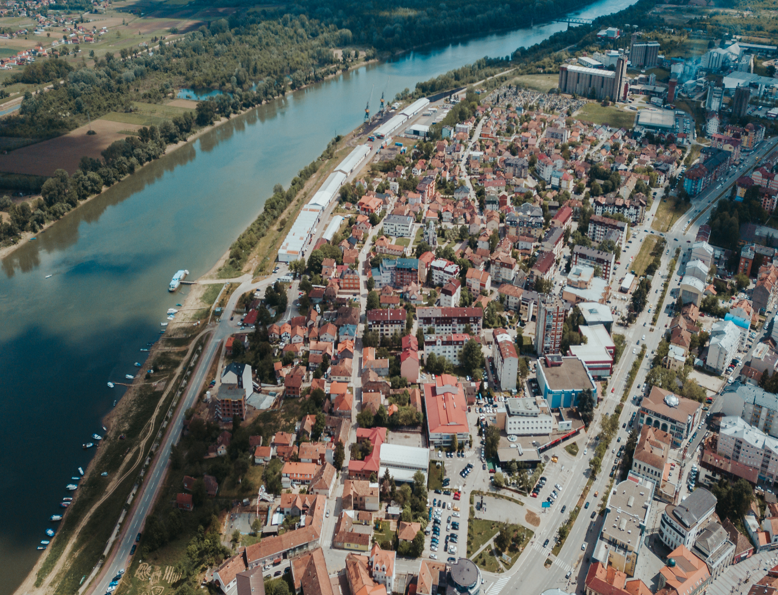
WHAT BIH HAS TO DO FOR CBAM UNTIL 2026?
Establishment of the MRVA system
as a prerequisite for establishment of ETS
Excemption for electricity
REGULATION (EU) 2023/956 of the European Parliament and of the Council of 10 May 2023 on the establishment of a Carbon Border Adjustment Mechanism
Art 2 (part 7)
If a third country or territory has an electricity market and there is no technical solution for the application of the CBAM to the importation of electricity into the customs territory of the Union from that third country or territory, such importation of electricity from that country or territory shall be exempt from the application of the CBAM.
Decarbonize technologies
taking into account a just transition
Key conditions:
Power exchange
Electricity market coupling
Establishment of ETS

Slide 5
WHAT BIH COMPANIES MUST DO UNTIL 2026?
Invest in cleaner production by improving production efficiency through digitalization and automation, enhancing energy efficiency in production processes, and producing energy from renewable sources.
Evaluate and improve the supply chain to enhance competitiveness and minimize direct and indirect exposure to CBAM.
Establishment of energy management.
Keeping track of emissions and reporting them accurately and take steps to reduce them, potentially reducing CBAM payments.

