Slide 1

From wastewater treatment to resource utilization
doc. Ing. Jakub Raček, Ph.D.
Energy summit Neum 2024

Slide 2
Content
01
02
03
04
Introduction, exploitation of selected resources from wastewater
Wastewater Recycling
Wastewater as a source of energy
Exploitation and utilization of nutrients
2

Slide 3
Introduction
01
Exploitation of selected resources from wastewater
3

Slide 4
Exploitation of selected resources from wastewater
Recycling of wastewater
Waste water treating for its next utilization
Wastewater – energy source
Exploitation of utilization of energy
Exploitation of utilization of nutrients
Material transformation of sewage sludge
4

Slide 5
Wastewater Recycling
02
Treating of wastewater for its next utilization
5

Slide 6
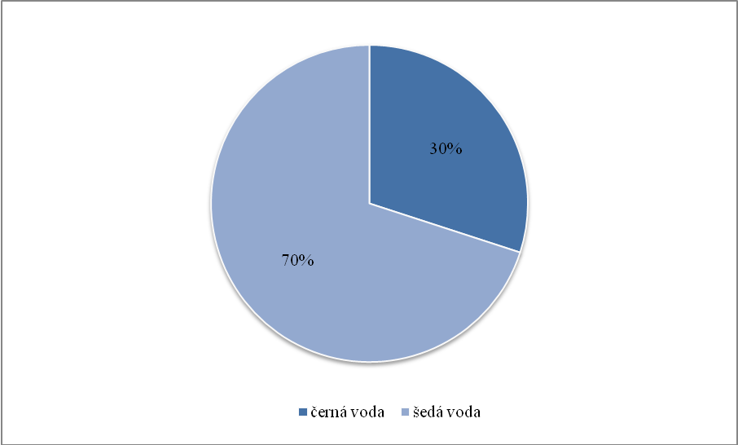
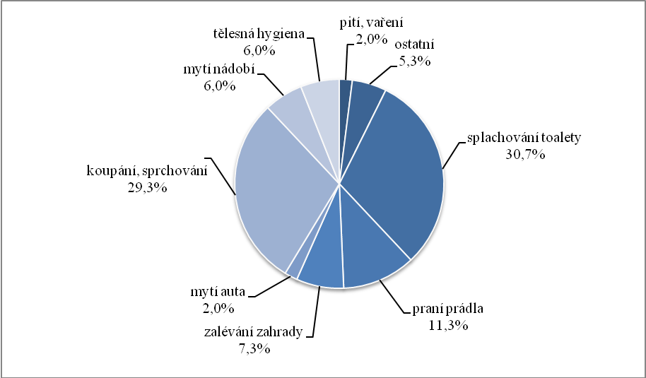
Graywater can generally be defined as slightly polluted wastewater from washing basins, showers, bathtubs, sinks and washing machines
Comparison of gray and black water production from household operations
Average daily water needs from household operations
6

Slide 7
Reuse of graywater in buildings
Legend: 1-shower, 2-washbasin, 3-washing machine, 4-toilet, 5-cleaning unit for gray and rainwater, 6-rainwater tank, 7-white water intake, 8-safety overflow, 9-sewage connection)
Graywater, according its origin, can be stated as follows:
i) unseparated graywater (i.e. graywater not separated from wash-basins, bathtubs, showers, kitchen sink, etc.),
ii) graywater from wash-basins for washing hands, baths and showers,
iii) graywater from washing machines,
iv) graywater from the kitchen sink, dishwasher,
v) other graywater.
7

Slide 8
​Graywater treatment options
.
ii) Physical way of treting
iv) Biological way of treating
vi) Combination of processes
i) Simple treatment
iii) Chemical way of treating
v) Natural based way of treating
8

Slide 9
Wastewater as a source of energy
03
Exploitation and utilization of energy
9

Slide 10
Wastewater as a source of thermal energy for households
17%
Up to 40% savings
Others
20%
Boiling
63%
Heating
The average consumer, especially during showering and bathing, discharges up to 40% of the thermal energy produced in residential buildings into the internal sewage system of buildings
Lightning, cooking, washing, others
Water boiling
Heating and cooling
10

Slide 11
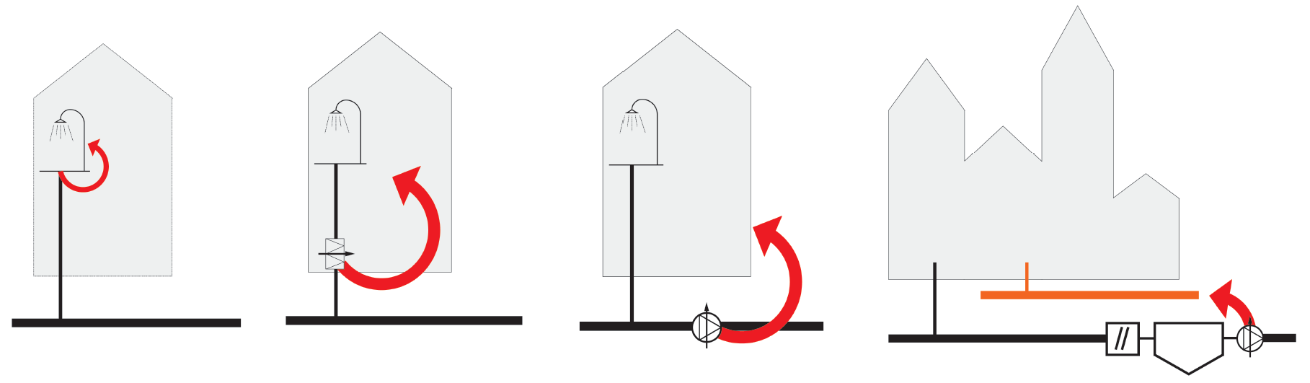
Extraction and reuse of thermal energy from waste water
1
2
3
4
11

Slide 12
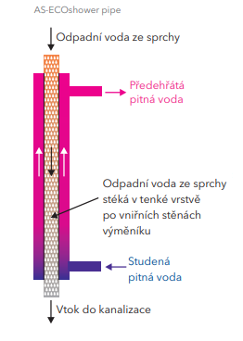
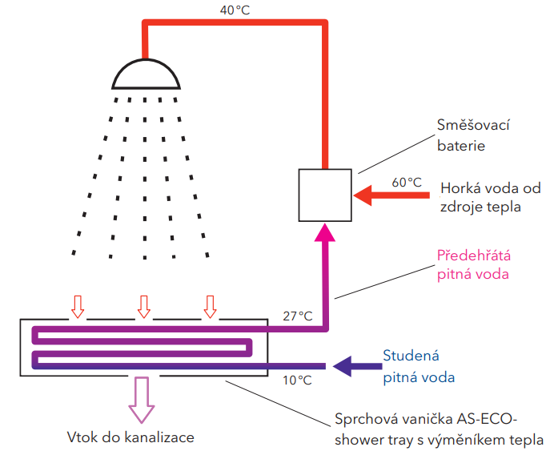
Decentralized acquisition and use of thermal energy
12

Slide 13
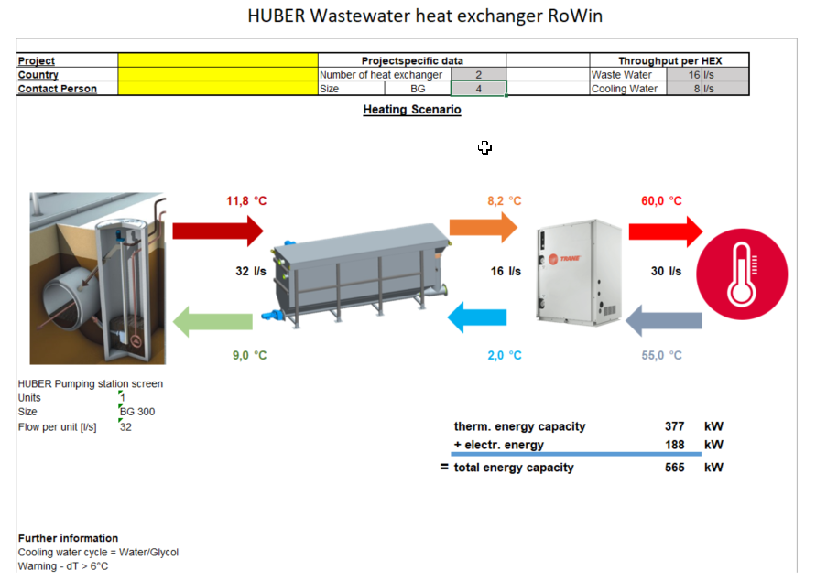
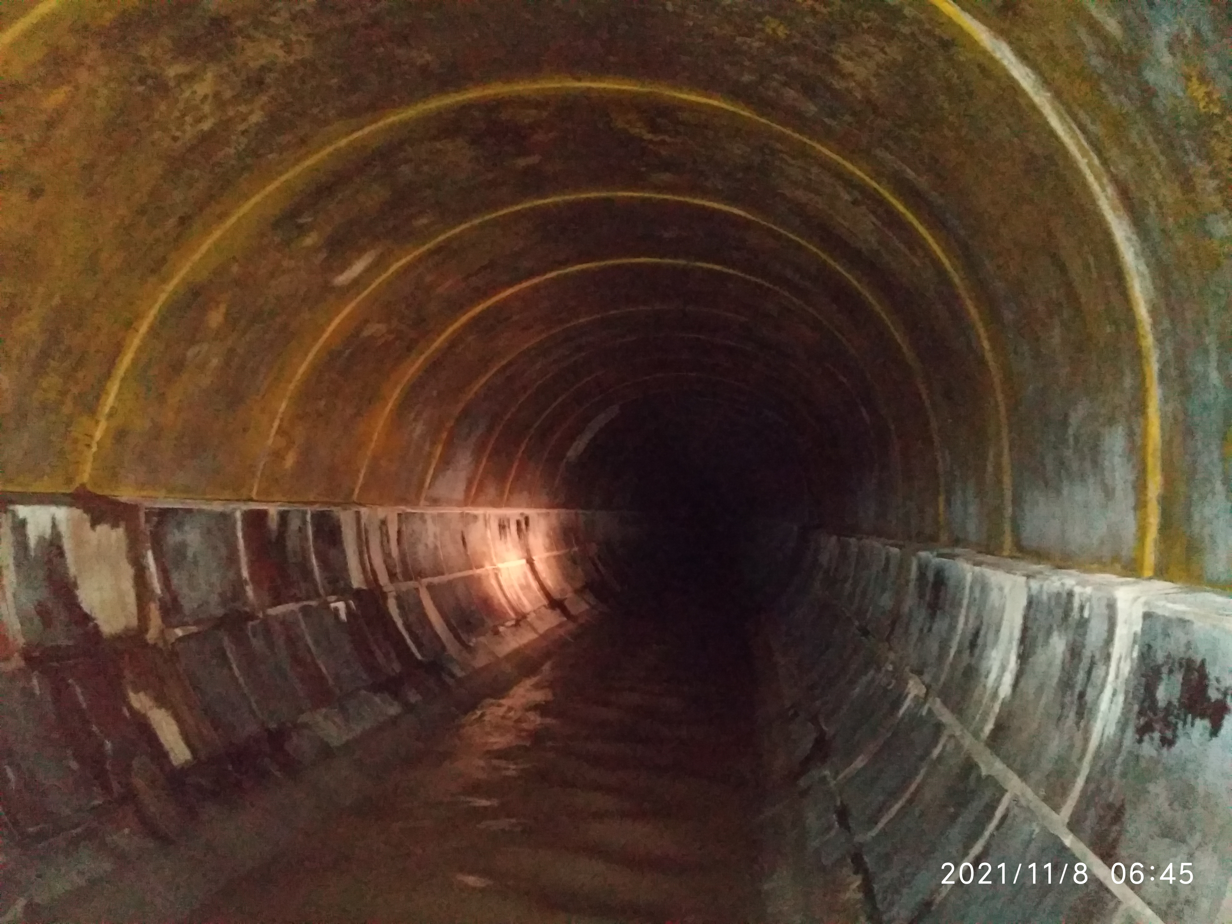
Example of taking and using thermal energy from the sewage system = centralized solution
13

Slide 14
Nutrients exploitation and utilization
04
Material transformation of sewage sludge
14

Slide 15
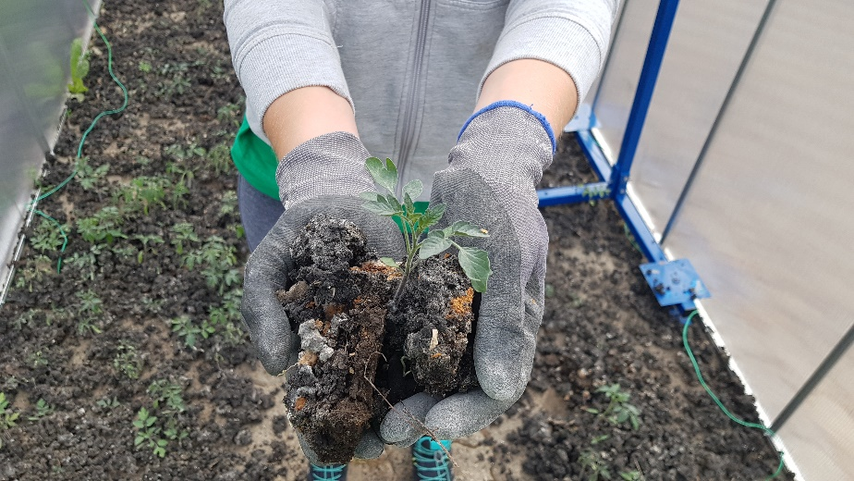
Sewage sludge treatment
The strategic management of sewage sludge is a highly topical topic not only in the EU...
15

Slide 16
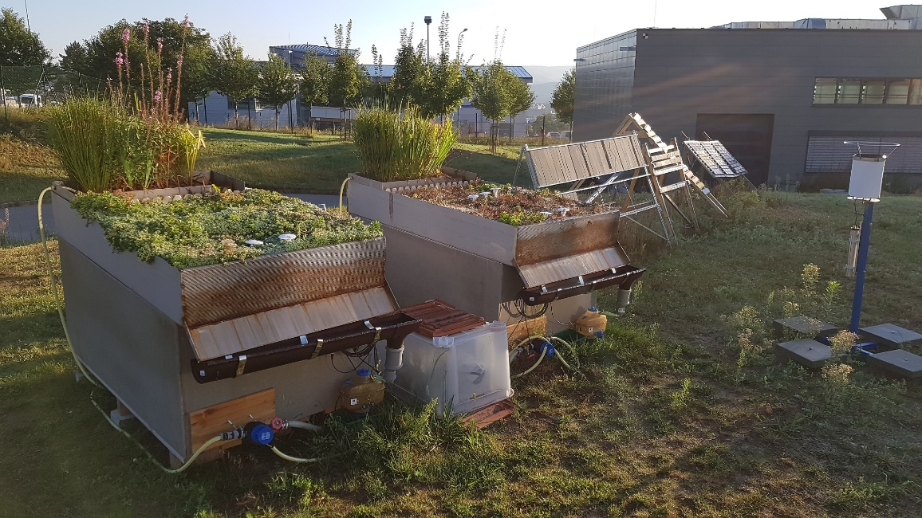
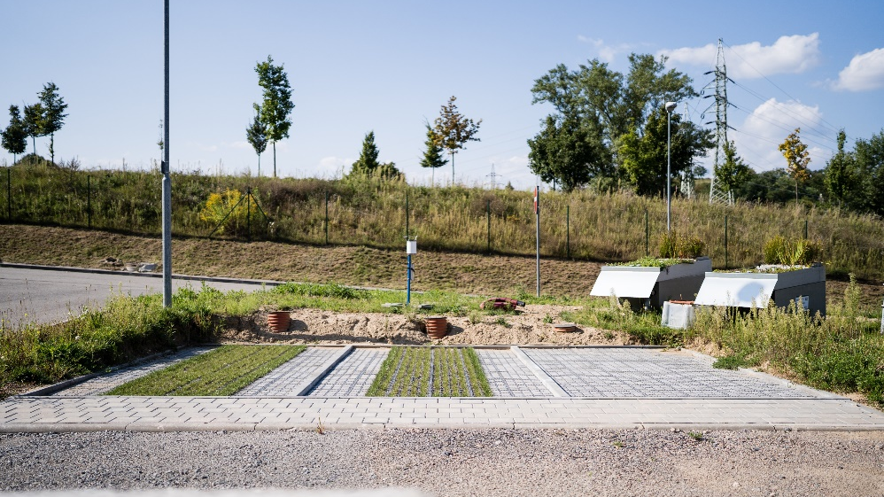
Material transformation of sewage sludge
The goal is the material transformation of sewage sludge into another usable product in accordance with the principles of the Circular Economy and the idea from waste to product. The means can be pyrolysis / torrefaction of sewage sludge with the implementation of a solid carbonaceous product into the blue-green infrastructure.
16

Slide 17
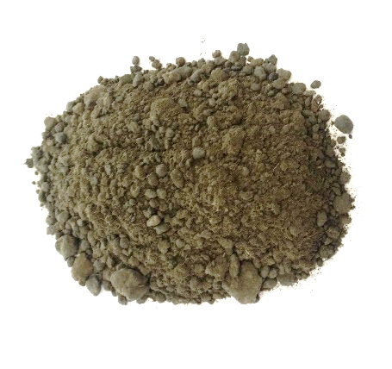
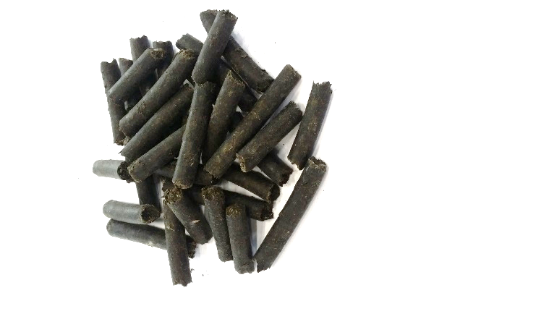
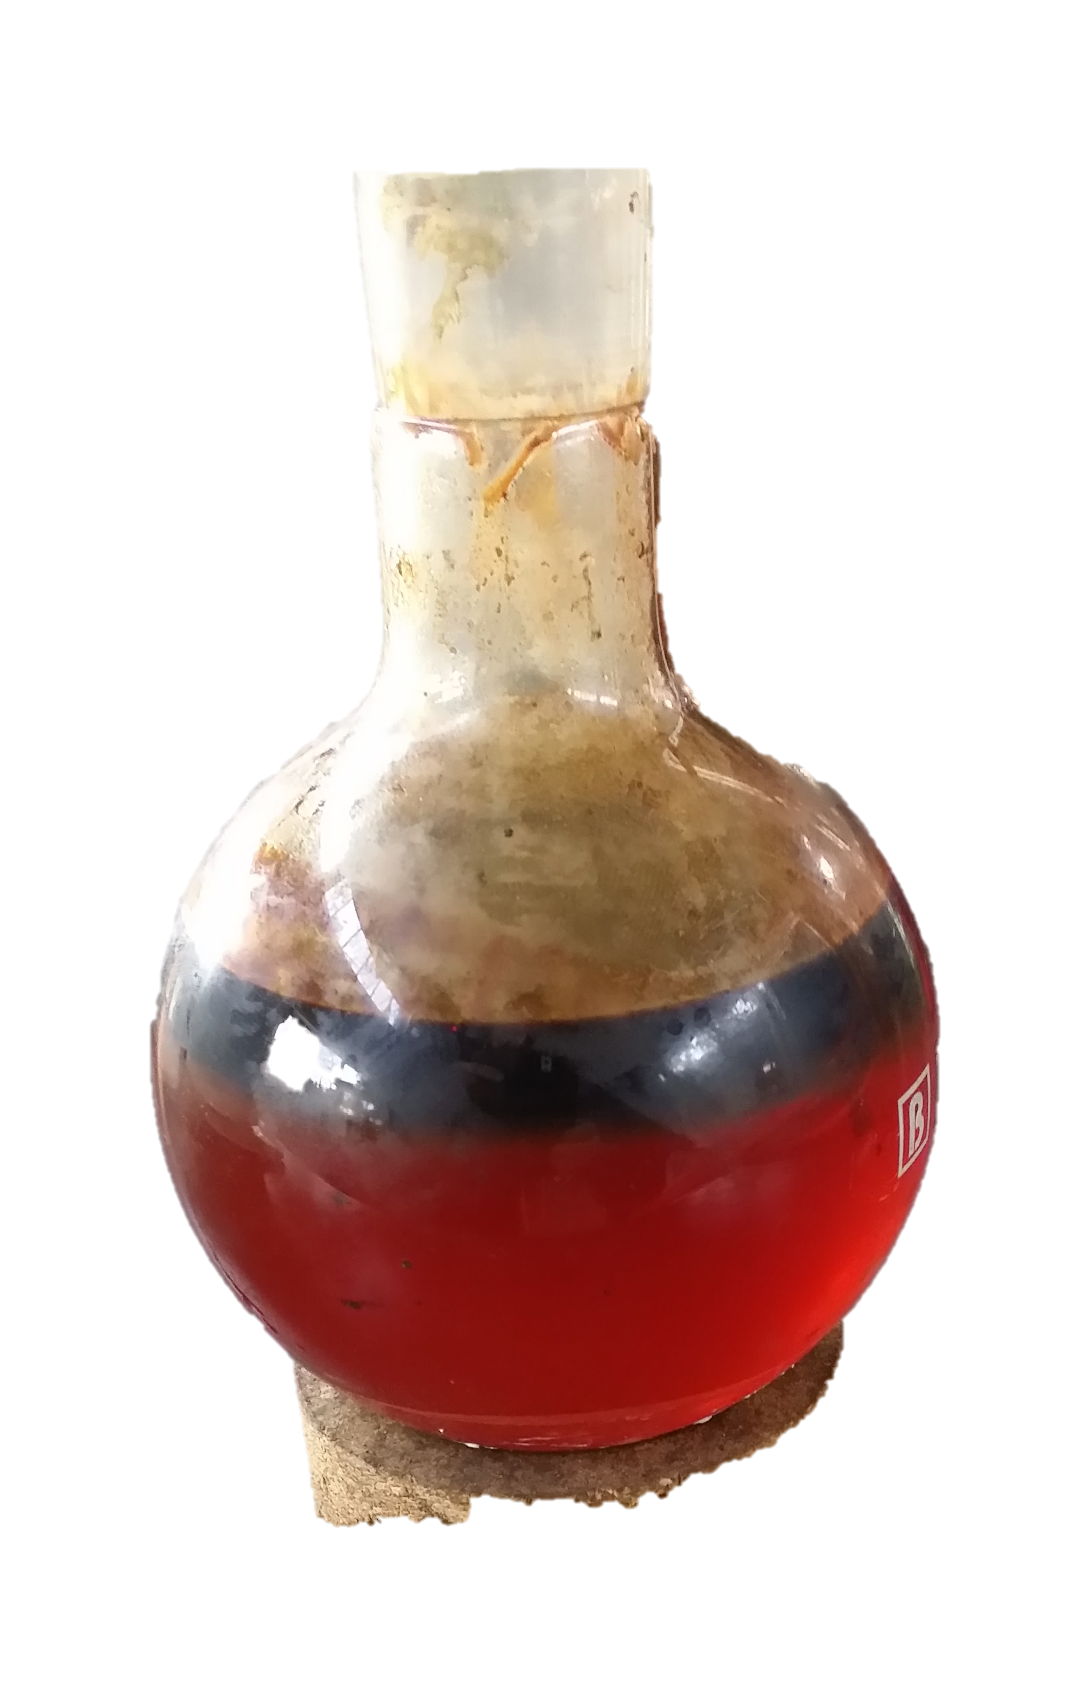
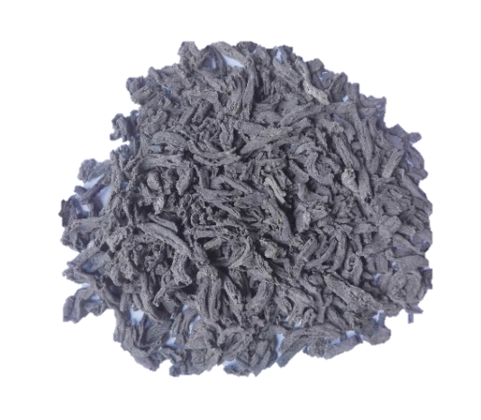
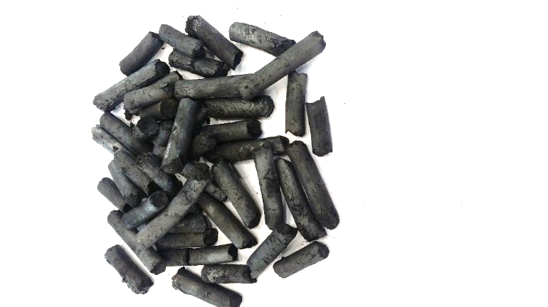
Pyrolysis / torrefaction of sewage sludge (SS)
Dried SS (dust composition)
Pelletized SS (pellets dia. 6 or 8 mm)
ii) Pyrolysis oil and iii) pyrolysis gas
+additives
Dried SS (noodle-shaped)
Pyrolysis / torrefaction
i) Solid Carbonaceous Product (SCP), Biochar (BC)
17

Slide 18
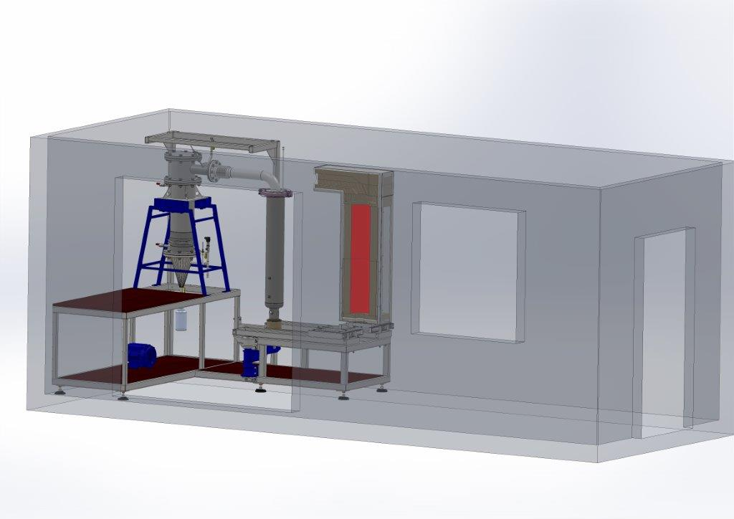
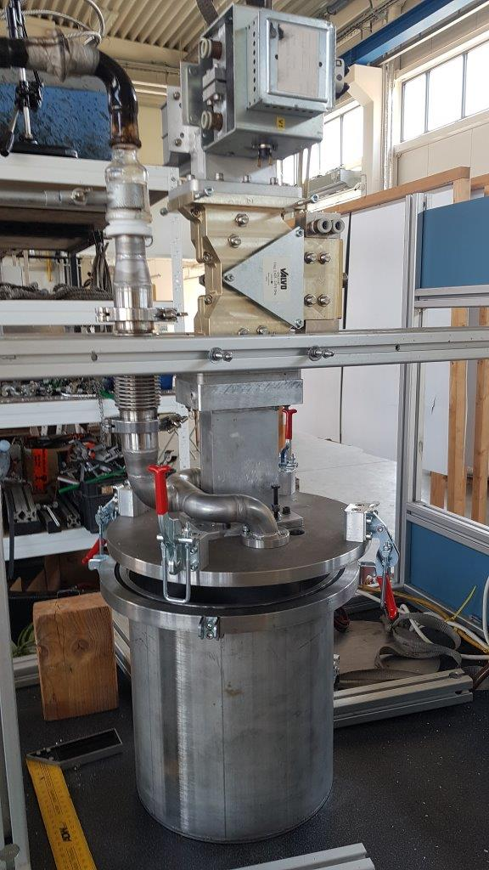
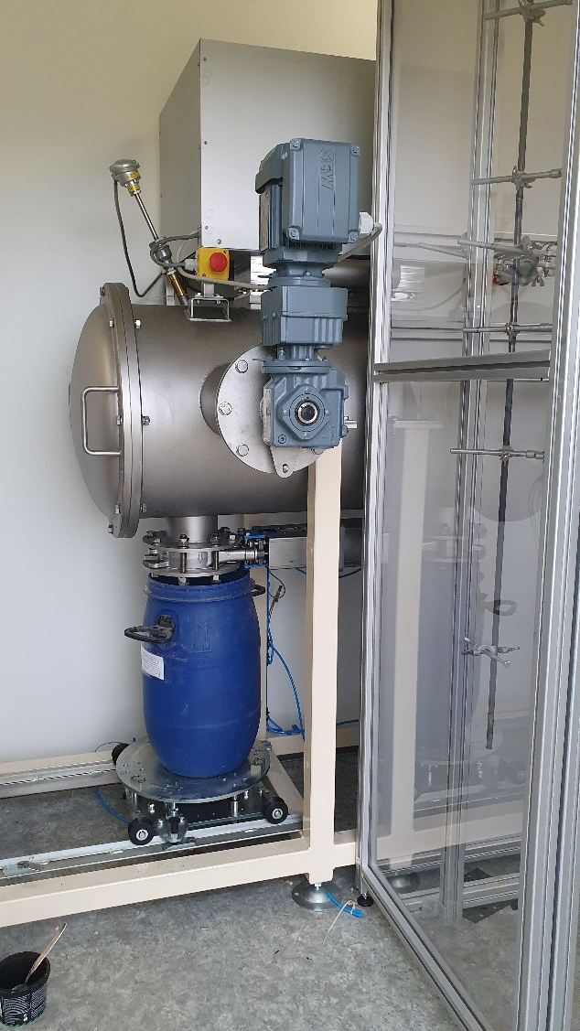
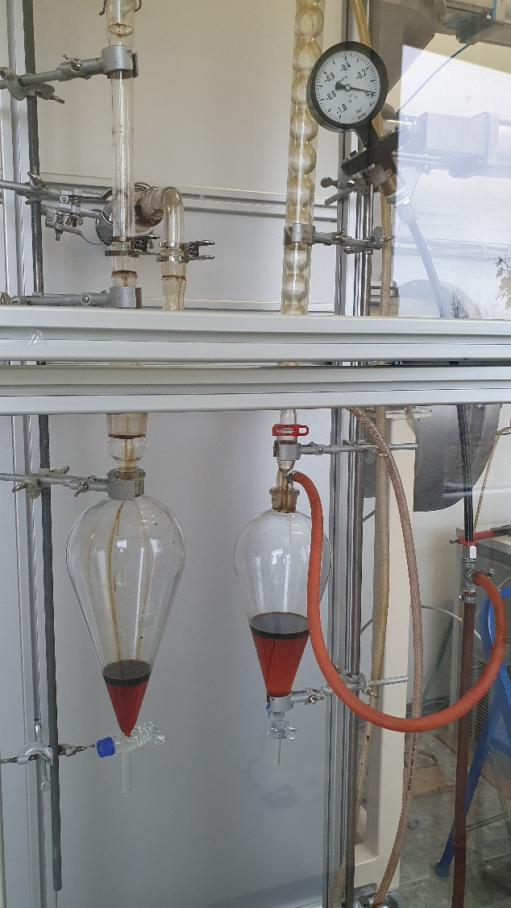
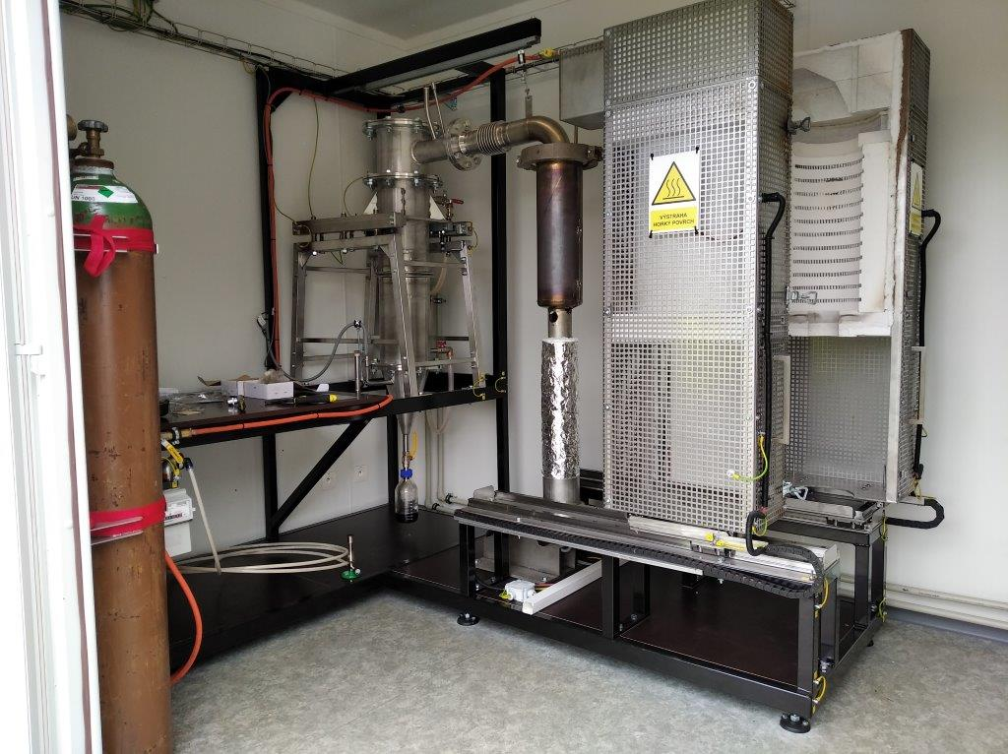
Pyrolysis / torrefaction units at AdMaS BUT Brno
18

Slide 19
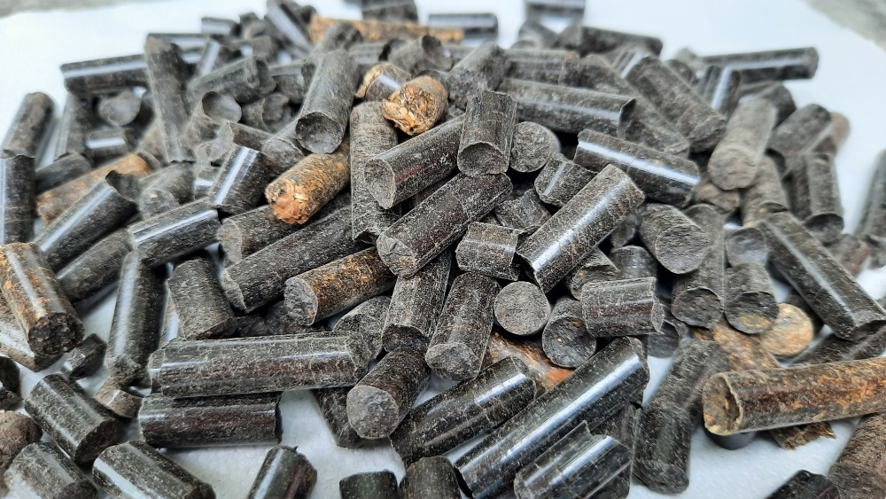
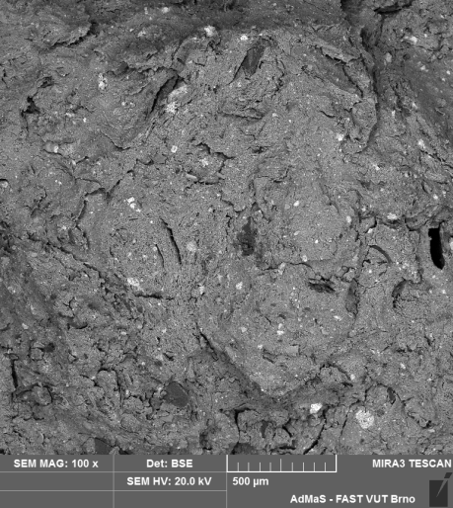
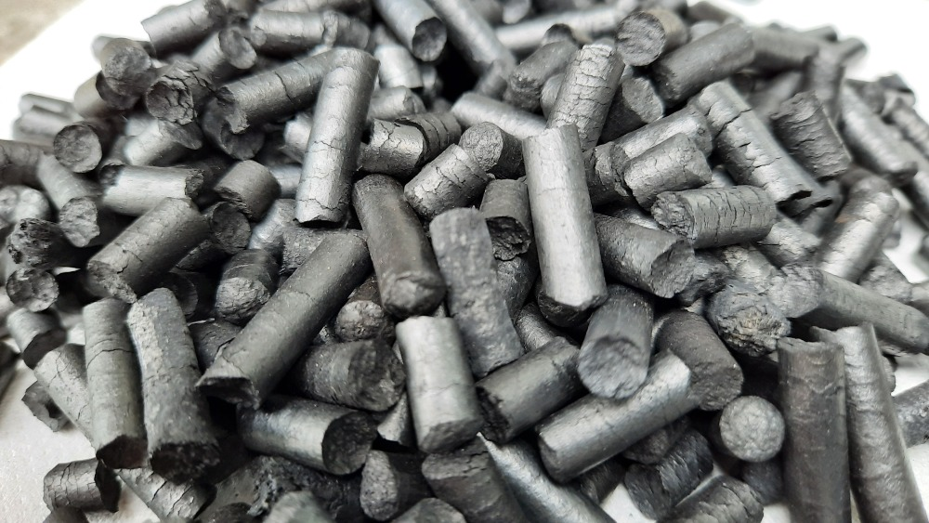
Solid carbonaceous product, biochar after pyrolysis
Input
SS
SEM
Biochar
SCP
Biochar
19

Slide 20
Thank you for your attention
Any questions ?
Jakub.Racek@vut.cz
+420 604 981 530
https://www.vut.cz/en/people/jakub-racek-81857
20

