Slide 1
Strategies and Building Renovation Programs in Bosnia and Herzegovina
Neum, 27.04.2023.

Slide 2
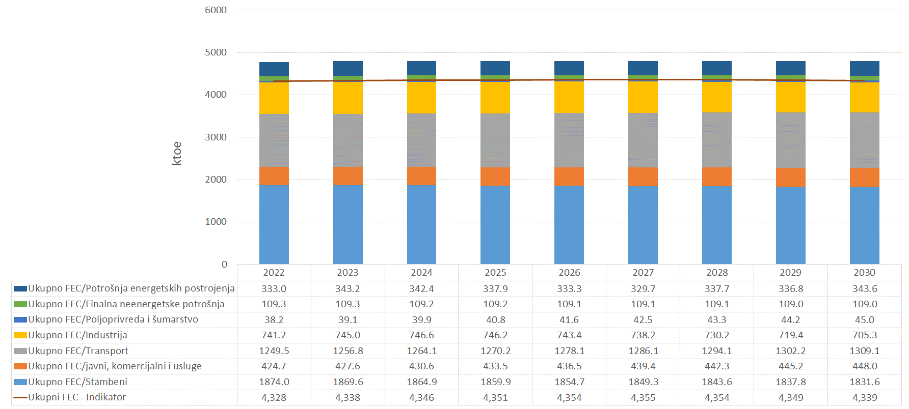
Energy Efficiency Targets in 2030
Bosnia and Herzegovina Targets:
Energy Efficiency– Primary Energy Consumption (PEC) | Energy Efficiency – Final energy Consumption (FEC)
6.84 Mtoe | 4.34 Mtoe
European Commision Targets:
Energy Efficiency– Primary Energy Consumption (PEC) | Energy Efficiency – Final energy Consumption (FEC)
6.50 Mtoe | 4.34 Mtoe
More ambitious PEC target was adopted compared to the proposal from MoFTER BiH

Slide 3
GIZ Project Decarbonisation of Energy Sector in BiH
Sub-project 1
STRATEGIC FRAMEWORK ON DECARBONIZATION
Sub-project 2
RESIDENTIAL BUILDING RENOVATION PROGRAMS
Sub-project 3
DEMONSTRATION of INNOVATIVE PROCESSES
The core of this framework: NECP and ECPs
Building Renovation Strategy, Renewal Programs,Systematic approach to programming
Reform of the existing RE Support schemes, Participation of citizens (REC), Measures to achieve NECP targets
Objective:
The conditions for the decarbonization of the energy sector in BiH have improved

Slide 4
INTEGRAL BUILDING RENOVATION STRATEGY IN BOSNIA AND HERZEGOVINA UP TO 2050

Slide 5
Year | 2020 | 2025 | 2030 | 2040 | 2050
FEC, GWh/y | 11,116.0 | 10,915.5 | 10,715.0 | 9,944.0 | 8,986.0
Expected FEC in residential buildings
Year | 2020 | 2025 | 2030 | 2040 | 2050
Expected yearly investments (M BAM) | 325.3 | 319.1 | 318.6 | 359.1 | 374.4
Expected yearly investments for EE measures in residential buildings to reach the FEC (BAM)

Slide 6
Year | 2020 | 2025 | 2030 | 2035 | 2040 | 2045 | 2050
FEC, GWh/y | 6,212.9 | 6,100.84 | 5,889.9 | 5,405.4 | 4,920.9 | 4,436.4 | 3,951.9
Expected FEC in residential buildings
Year | 2025 | 2030 | 2035 | 2040 | 2045 | 2050
Expected yearly investments (M BAM) | 133.6 | 132.21 | 176.31 | 178.31 | 164.31 | 174.31
Expected yearly investments for EE measures in residential buildings to reach the FEC (BAM)

Slide 7
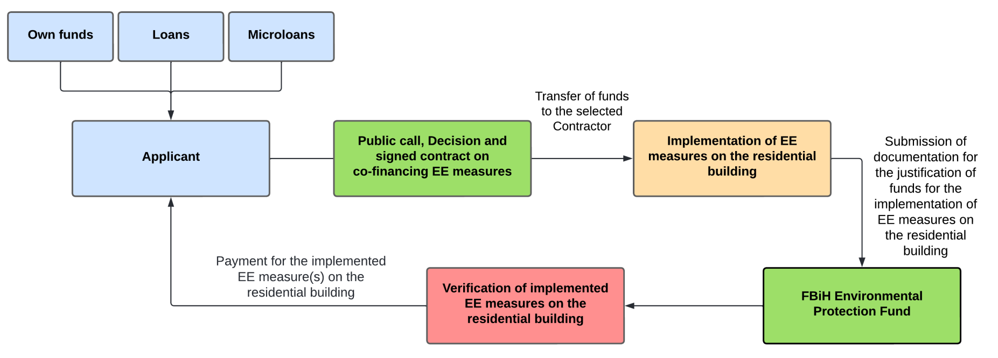
Sustainable model with clear steps of implementation
Financial construction of the model for cofinancing EE renovations of residential buildings

Slide 8
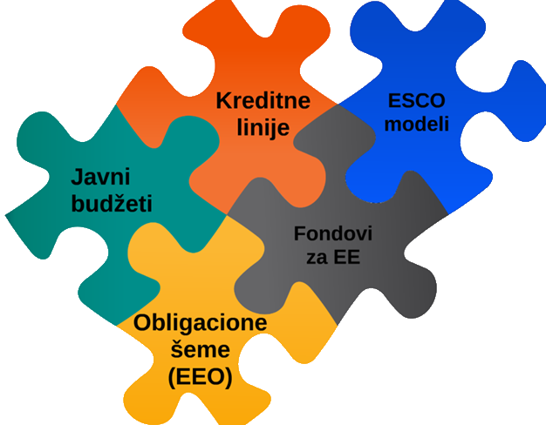
USAID EPA project activities
NECP and Building Renovation Strategies envisage the introduction of Energy Efficiency Obligation schemes as a model for financing EE measures
USAID EPA is working on the preparation of Energy Efficiency Obligation schemes model
It includes a comprehensive system solution for financing energy efficiency measures as well as implementation
USAID EPA created a tool for developing scenarios for the collection of fees from energy sources in order to meet the financing needs of EE measures and the goals set through the NECP
Additional technical assistance for the FBiH Environmental Protection Fund
E-application - IT system for online application of households and small and medium-sized enterprises for incentives for EE measures
Analysis of the goods and services market for the EE sector

Slide 9
Thank you!
 | Sanja Kapetina Head of Department for Secondary Energy and Projects Sector of Energy Ministry of Foreign Trade and Economic Relations of Bosnia and Herzegovina Musala 9 71000 Sarajevo Tel: +387 (0) 33 22 64 61 Fax : +387 (0) 33 55 25 12 e-mail: sanja.kapetina@mvteo.gov.ba web: www.mvteo.gov.ba

