Slide 1
E-mobility and Market Study in Bosnia and Herzegovina

Slide 2
Review of the existing institutional framework in the non-technical aspects of e-mobility
Road traffic model in Bosnia and Herzegovina by 2050
Possibilities for electrification of the fleet in BiH
Financing options for e-mobility
Recommendations on necessary policy measures

Slide 3
Review of the existing institutional framework in the non-technical aspects of e-mobility
To date, no specific laws have been adopted to transpose the requirements of Directive 2014/94/EU on the deployment of alternative fuels infrastructure and create legal preconditions for defining the starting framework of measures for market development with regard to alternative fuels in the transport sector and the development of appropriate infrastructure.
Policies and planning documents adopted at the level of BiH and entity and cantonal laws (with the exception of electricity in the RS and BD) only touch on a certain aspect of e-mobility and there is no systemic and harmonized legal regulation that would be appropriate to the development and introduction of e-mobility in Bosnia and Herzegovina.
Framework transport policy of Bosnia and Herzegovina for the period of 2015-2030
Framework energy strategy of Bosnia and Herzegovina until 2035. However
Energy Efficiency Action Plan in Bosnia and Herzegovina
Renewable Energy Sources (RES) Action Plan in Bosnia and Herzegovina

Slide 4
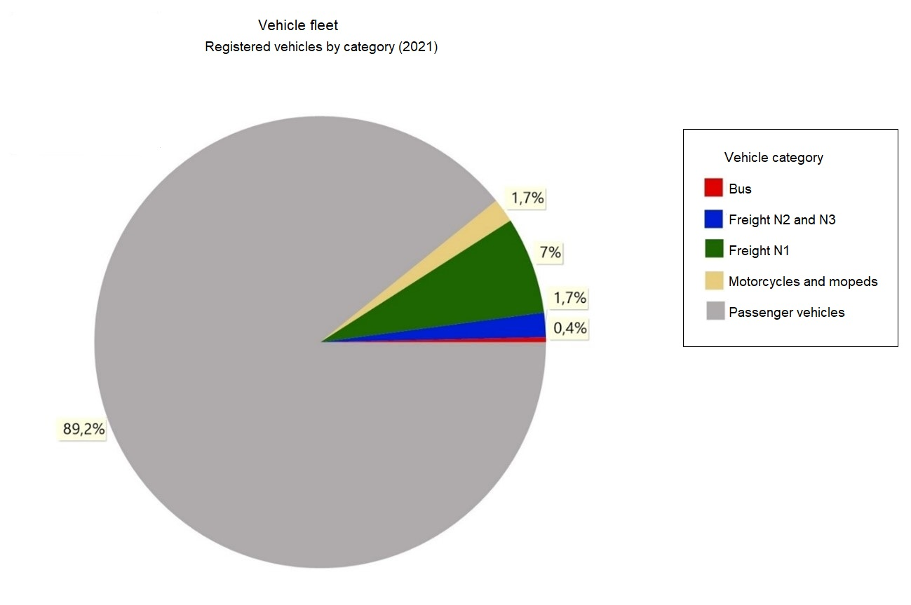
Road traffic model in Bosnia and Herzegovina by 2050
Scenario analysis of the vehicle fleet structure, energy consumption, CO2 emissions, and load diagrams of the power system due to charging of electric vehicles
LEAP (Long-Range Energy Alternatives Planning System) software tool
Two scenarios have been developed:
Reference scenario (BAU)
E-mobility scenario
The modeling was done using the "Stock turnover" method, which assumed the structure of newly registered vehicles in a given year (according to energy sources and vehicle categories)

Slide 5
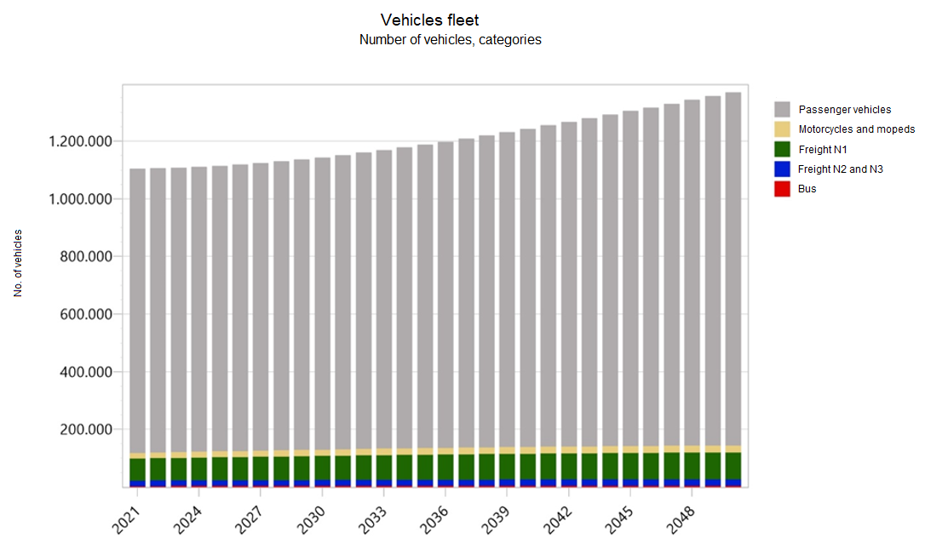
The modeling results for the E-mobility scenario
Projections of the total vehicle fleet by categories.

Slide 6
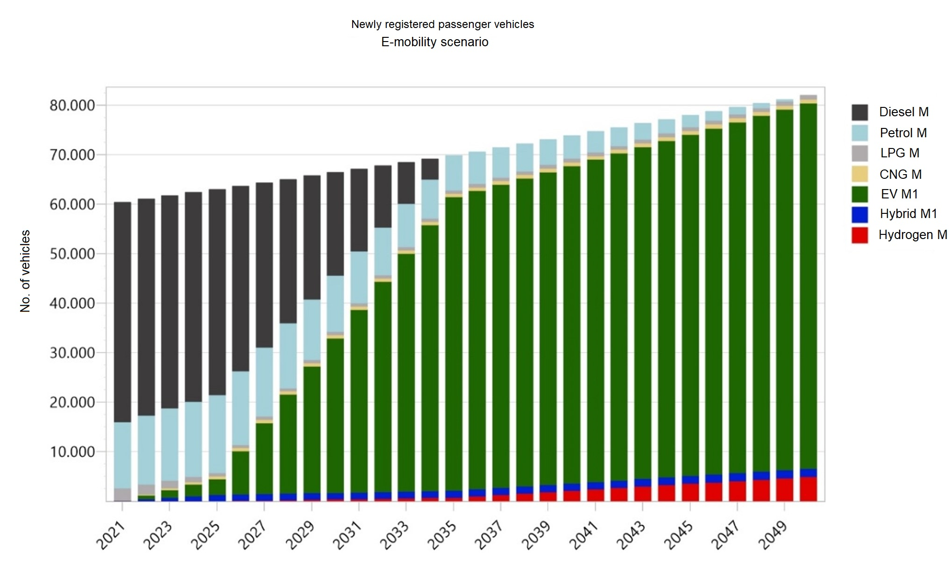
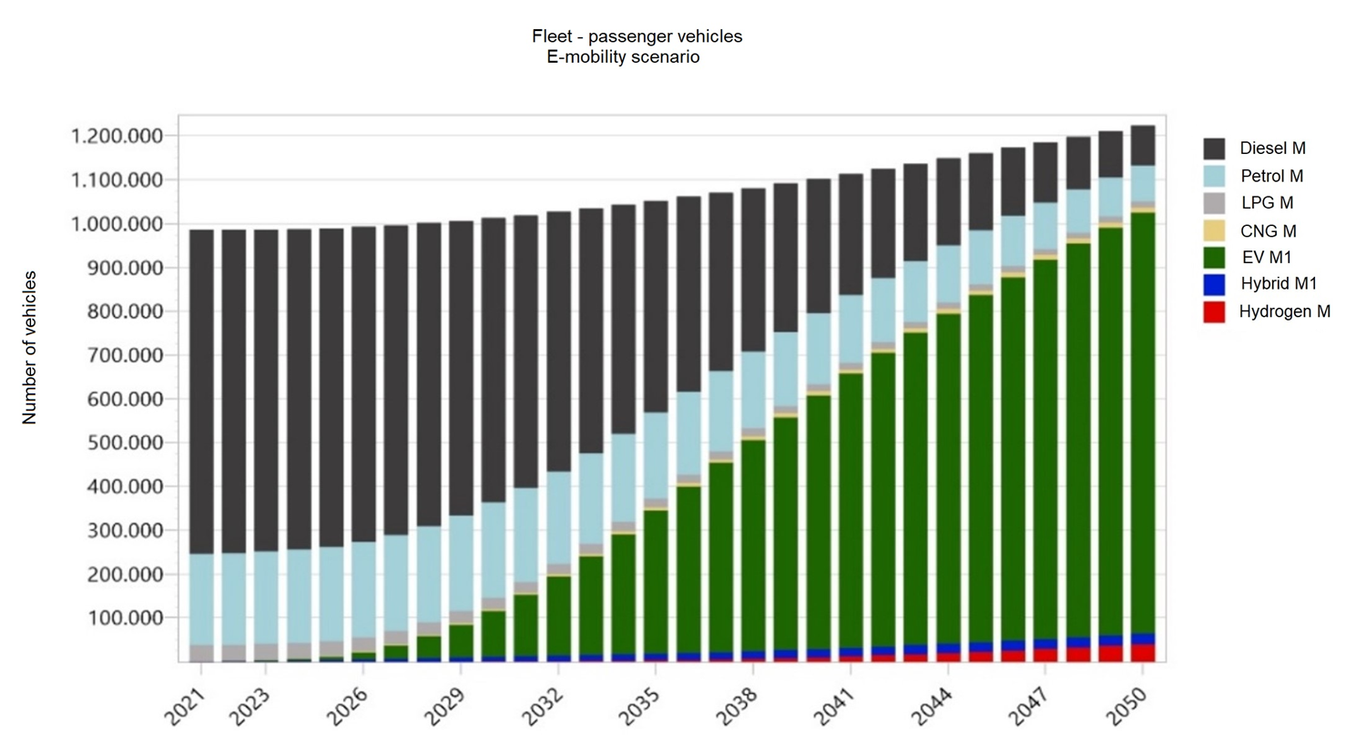
The modeling results for the E-mobility scenario

Slide 7
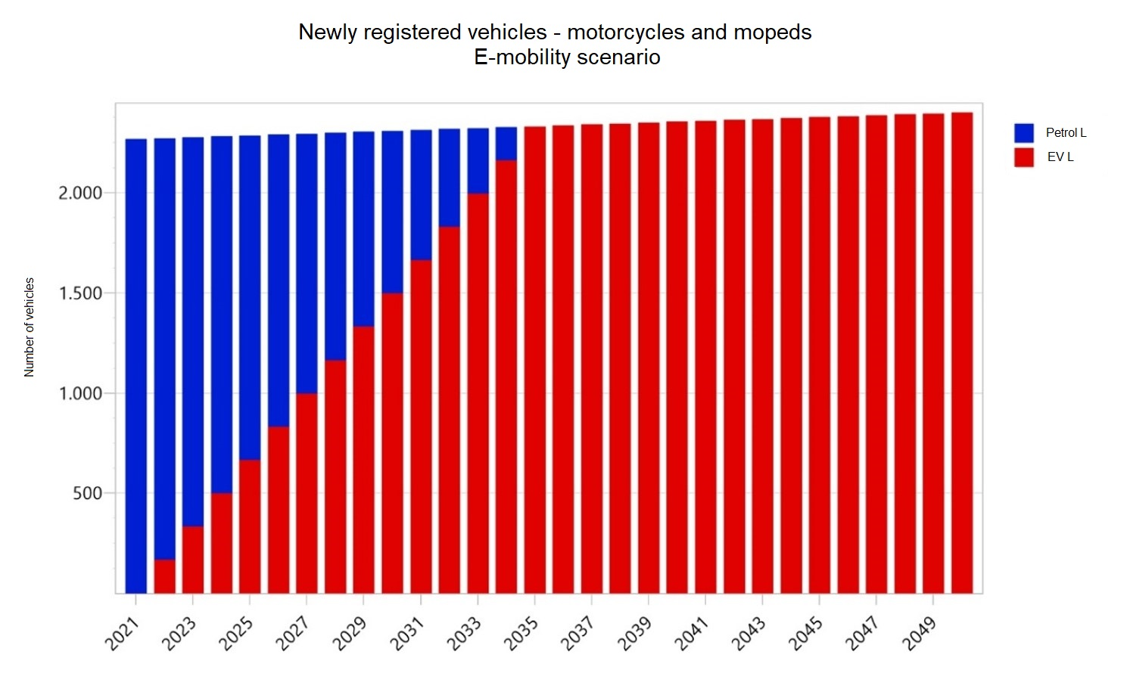
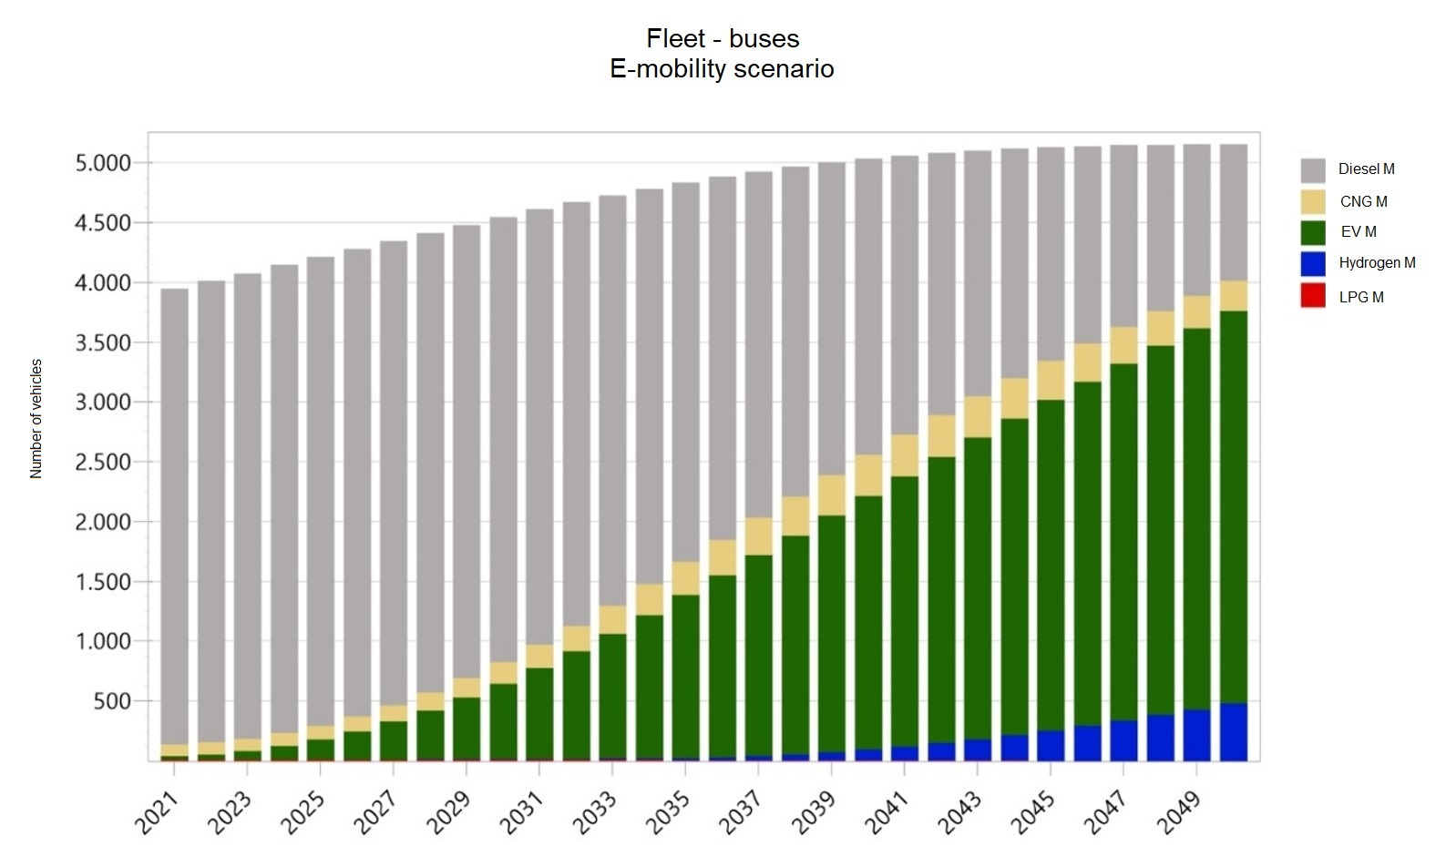
The modeling results for the E-mobility scenario

Slide 8
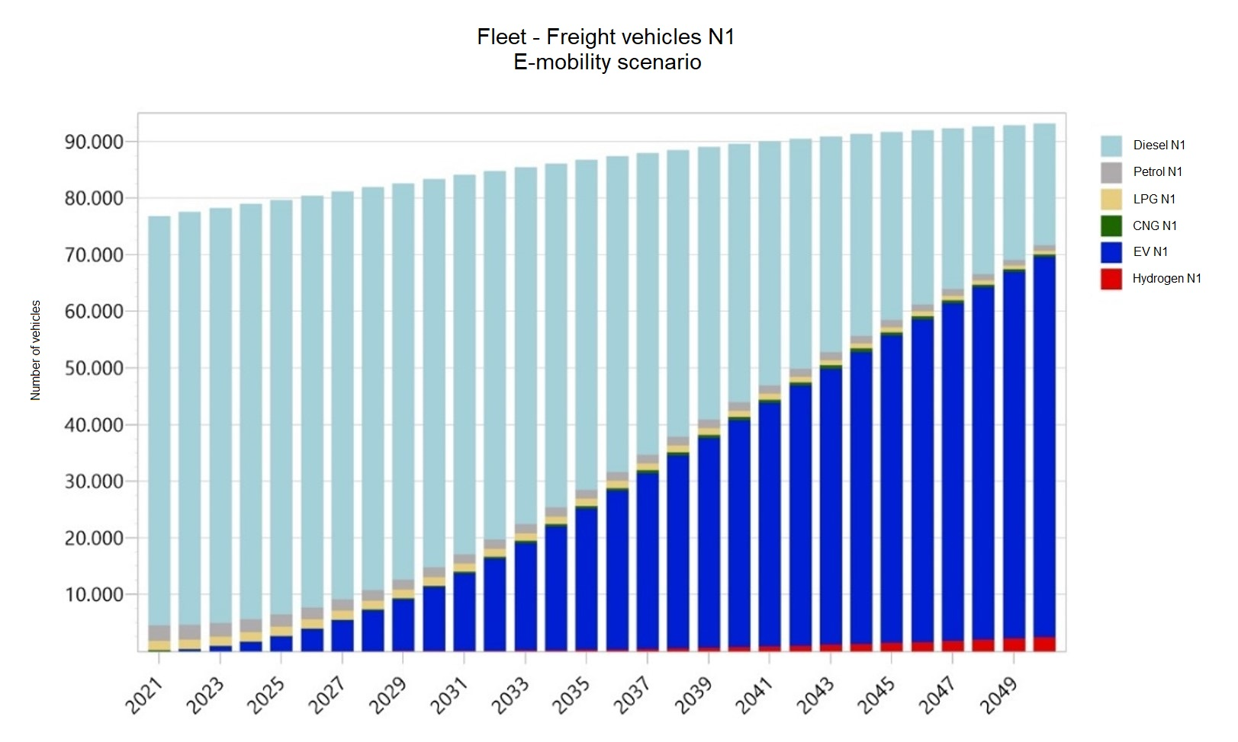
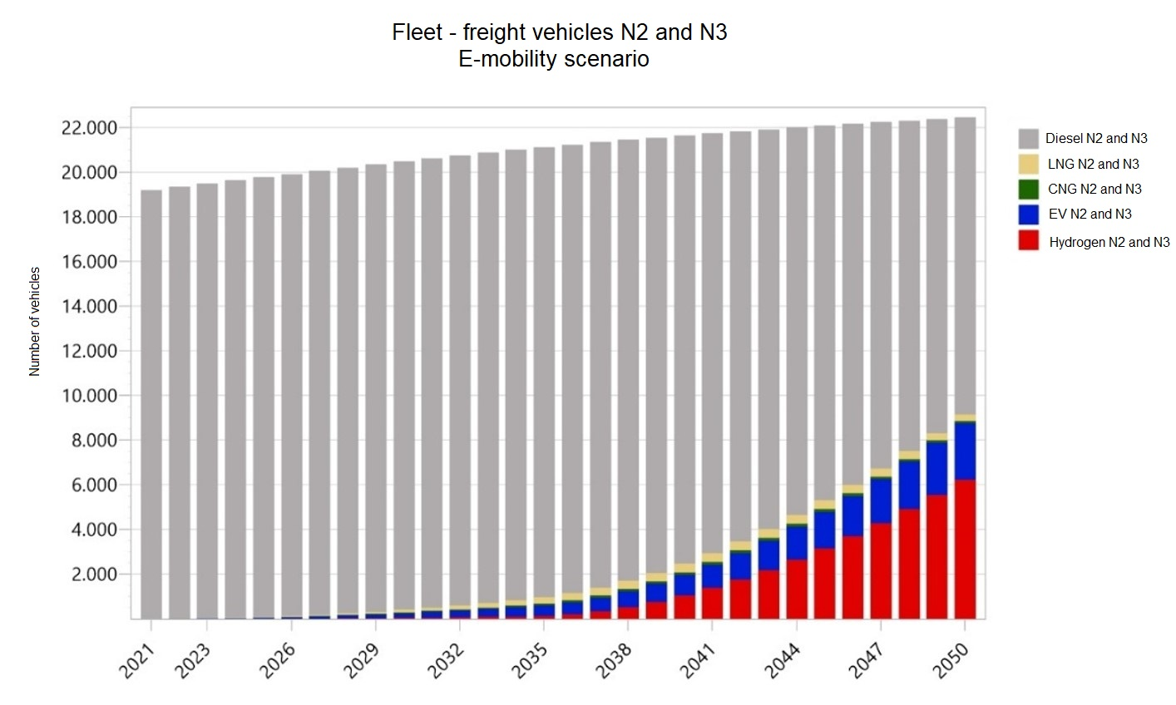
The modeling results for the E-mobility scenario

Slide 9
Possibilities for electrification of the fleet in BiH
Identifying possibilities for the electrification of the BiH fleet:
Viewed data from the model and compared with trends in the countries of the European Union
Passenger cars make up the largest share of electric vehicles in the total vehicle fleet
Highly educated, well-to-do people between the ages of 35 and 54 are most likely to choose an electric car for their first vehicle or to replace their conventional vehicle with an electric passenger car for their next purchase
Development of the network of filling stations
Electrification of freight traffic
Significant savings in energy consumption, as well as a significant reduction in CO2 emissions considering the large average mileage that vehicles travel, as well as the fact that 92% of vehicles in this category use diesel fuel as a drive.
The assumption that by 2030 the share of electric vehicles in the total number of vehicles from the N1 category will be between 5 and 10%, while by 2050 it will reach 45%
Electrification of the public passenger transport fleet
Large annual mileage concentrated in city centers
Significant reduction of CO2 emissions, reduction of energy consumption in the form of fossil fuels, improvement of air quality in city centers, reduction of noise levels and general improvement of the quality of life of the population in the city
It is estimated that the share of electric buses in the total number in BiH will be 64%

Slide 10
Financing options for e-mobility
There is a need to establish certain incentive mechanisms (due to the relatively high cost of electric vehicles).
Financing of e-mobility can be divided into several phases:
Phase 1 (short term) which represents the period of the next few years during which the prerequisites for the development of e-mobility in BiH should be created.
Phase 2 (medium term) which represents the period during which e-mobility will gain significant momentum globally and during which e-mobility will become "almost" cost competitive.
Phase 3 (long term) when e-mobility becomes a competitive activity compared to conventional mobility.
Fiscal instruments (customs and taxes)
Ecological taxes and charges in Bosnia and Herzegovina
Grants
International financial institutions
Public and private companies

Slide 11
Recommendations on necessary policy measures
Construction and Spatial Planning Law
Spatial Planning Law
Law on the Promotion of Clean and Energy-Efficient Vehicles in Transport - based on Directive 2019/1161
Law on the Establishment of Infrastructure for Alternative Fuels - DIRECTIVE 2014/94/EU
National Policy Framework for the Establishment of Infrastructure and Development of the Market for Alternative Fuels in Transport - DIRECTIVE 2014/94/EU
Regulation on unit fees, corrective coefficients, and closer criteria and standards for determining a special environmental fee on motor vehicles
Law on Air Protection in the Federation of Bosnia and Herzegovina, Law on Environmental Protection in Republika Srpska
Law on Road Traffic Safety in Bosnia and Herzegovina

Slide 12
Institutions responsible for establishing a legal framework in the field of e-mobility.
State, entity, and cantonal ministries of communication and transportation
Entity and cantonal ministries of spatial planning, municipal/city urban planning services
Entity ministries of energy
Fund for Environmental Protection of FBiH, Fund for Environmental Protection and Energy Efficiency of RS
Government of FBiH, Government of RS, Government of BD
FERK - Regulatory Commission for Energy in FBiH, RERS - Regulatory Commission for Energy in RS
Electric power companies
Distribution system operators
Indirect Taxation Administration of BiH
Entity and cantonal ministries of internal affairs
JP Autoceste FBiH, JP Autoputevi RS

Slide 13
Thank you for your attention!
Arnesa Borčak
UNDP, Project Manager

