Slide 1
Emissions Trading System Design Options Paper: Scope and Cap Stringency
BOSNIA AND HERZEGOVINA
Energy Summit

Slide 2
BACKGROUND
Bosnia and Herzegovina has developed an emissions trading roadmap
Starting to consider and plan how the various elements of the EU emission trading system (ETS) and related legislation can be introduced and implemented to enable carbon pricing in a timely manner
In the preliminary phase, the focus is on starting a dialogue in the country to explore the main design elements of emissions trading
BiH has also passed Monitoring, Reporting and Verification legislation for Greenhouse Gas emissions and reports electricity production emissions and CO2 intensity through the Energy Community.

Slide 3
BACKGROUND
The World Bank is providing technical assistance, working with the Ministry for Foreign Trade and Economic Relations, as well as other donors, on a one-year project focusing on ETS design options, including computable general equilibrium (macroeconomic) modeling.
While there are several other design choices to be made in building an ETS, the decision was made to limit the analysis to scope and cap as they are early and fundamental decisions that need to be taken by the Government
Given the close relationship with the EU and political commitments to align with EU Climate Law, these design choices will also be influenced by the design of the EU ETS. Alignment and interactions with the NECP will also be considered.
To inform the report and modeling results, workshops with stakeholders will also be held throughout the report writing process.

Slide 4
TIMELINE
OUTPUT | DELIVERY
Consultant procurement | September – October 2022
Contracts signed | October 2022
Outline | October 2022
Modeling Scenarios* (noting this will be an iterative process) | December 2022 (inception report)
Workshop 1 | Mid-February 2023
Initial modeling results | Updating to reflect NECP assumptions Initial modeling results expected later this month
First draft of report | April 2023
Additional modeling results | April / May 2023
Workshop 2 | May 2023
Final report + slide deck | June 2023

Slide 5
ETS Design Options Paper

Slide 6
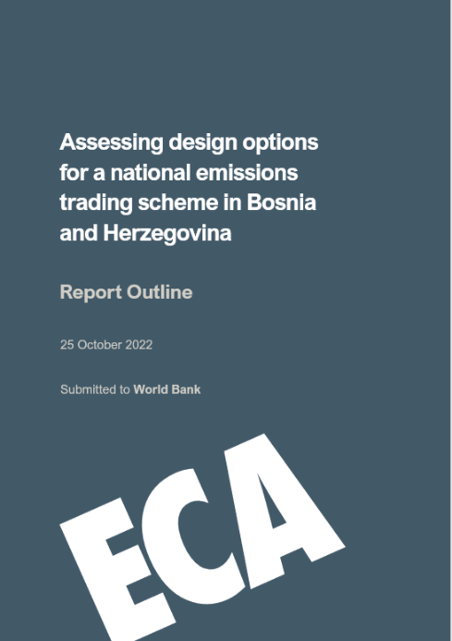
OUTLINE
Section 1: Introduction and background
Section 3: Assessment approach
National context: drivers for an ETS, prevailing policies and targets, economic and political context
Energy Community context: Regional commitments and work through Energy Community
European Union context: implications for accession, ETS harmonization, CBAM implications
Indicators to evaluate design
GEM-E3 CGE modelling approach
Section 4: Design options
Approach to select design options
Outline design options
Results of CGE modelling and other indicators
Comparison and ranking design options
Section 2: Carbon pricing in policy mix
Interaction and role of ETS in policy mix, including:
Potential need for refocusing fuel subsidies
Progress towards a market economy
Implications for industrial strategy and just transition
Coordination with renewable energy and energy efficiency policy
Section 5: Conclusions
Recommendations regarding design and chosen option + next steps

Slide 7
EVALUATION INDICATORS
Indicator | Assessment notes
Macroeconomic impact | This will be a direct quantitative output of the CGE modelling discussed in later slides Particular attention will be paid to impact on incentivised abatement choices within sectors
Impact on competitiveness | CGE modelling outputs will provide quantitative assessment of impact on traded sectors
Distributional impacts | Quantitative assessment of impact on bills and disposable income at different income levels Impact by sector will also be discussed qualitatively with respect to potential distributional concerns (eg regionally or on marginalised groups)
Interaction with existing policies | ETS can complement, overlap and/or conflict with other policies within targeted sectors Particular attention to be paid to any rationalization with fossil fuel price support Renewable energy capacity expansion plans and policy tools may also interact with ETS impact
Potential political barriers and institutional feasibility | The complex political structure of BiH needs consideration with respect to administration, verification and enforcement processes and powers
Legal feasibility | The scope of legislative drafting and amendments may differ by sector (a phased approach for implementation will be considered in light of this and other potential benefits)

Slide 8
MODELING SCENARIOS
The team, with input from the government, is developing a series of scenarios to model different options for ETS scope (e.g. which sectors will be covered) and cap ambition
The large-scale hybrid CGE model (GEM-E3-BIH) is a tailored version of the model used by European Commission, BiH and other WB6 countries.
The following aspects are varied: ETS sector coverage, level of cap ambition, allocation scheme, carbon revenue use
Results can help assess how different ETS designs help BiH achieve not only NDC but NECP scenarios and targets (for RE and EE by 2030 and beyond). Equally, how can NECP policies make the ETS more effective and reduce its impact on the economy.

Slide 9
MODELING SCENARIOS
Sample scenarios include:
Initially lower ETS prices (as a % of EU allowance price forecast) vs. delayed alignment with EU allowance prices vs. Immediate harmonization with ETS price forecast
Scope: Power sector initially then expanding to industry (as currently in the EU ETS) vs. immediate EU ETS coverage
Revenue use: A mix of lump sum to households, R&D investments, labor force training etc.
Regional carbon pricing: BiH only vs. Energy Community members adopting a carbon price

Slide 10
Other work
The World Bank is supporting other carbon pricing work ongoing in the region, including:
Montenegro (improving current ETS and looking at options to expand the carbon price signal through crediting or expanding to other sectors), Türkiye (developing a pilot ETS for implementation) and Ukraine (core design elements for a national ETS) are advancing emissions trading work through the World Bank’s Partnership for Market Implementation
Serbia: modeling carbon pricing and CBAM impacts as part of a broader report on green and resilient growth
Upcoming: Regular Economic Report and Country Climate Development Report for Western Balkans will look at CBAM and carbon pricing

Slide 11
Thank You

