Slide 1
HOW CAN BUSINESS AND PRIVATE SECTOR INITIATIVES DRIVE ENERGY SECTOR REFORMS?
Examples from Bosnia and Herzegovina and SEE
Maria Đogić, PhD
PC „Elektroprivreda HZ HB” Mostar

Slide 2
The energy transition is happening right now!
Feasibility – profitability – compliance
Business and private sector initiatives as a catalyst for change

Slide 3
Why are power companies essential for energy sector reforms?
Examples from Bosnia and Herzegovina and SEE

Slide 4
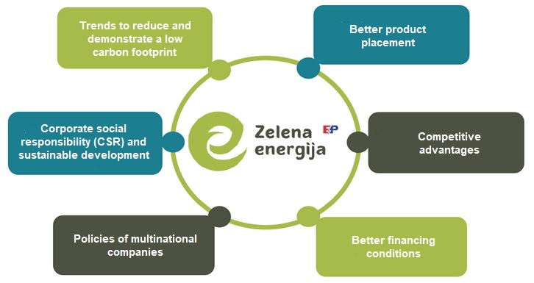
The „Green energy” model
What are „Green energy” models?
Why did we implement these models?
Why are these models interesting to our end consumers?
What are the contracting conditions?

Slide 5
The role of power companies in driving energy reforms
MH ERS – The „Energy sustainability for households” initiative
EPCG – Solari5000+ (Solari3000+ and 500+)
EPBiH – Charging stations for electric vehicles
HEP ESCO
Differentiation is key to achieving success

Slide 6
How can other stakeholders drive the energy sector reforms?
A proactive approach from business and citizen initiatives

Slide 7
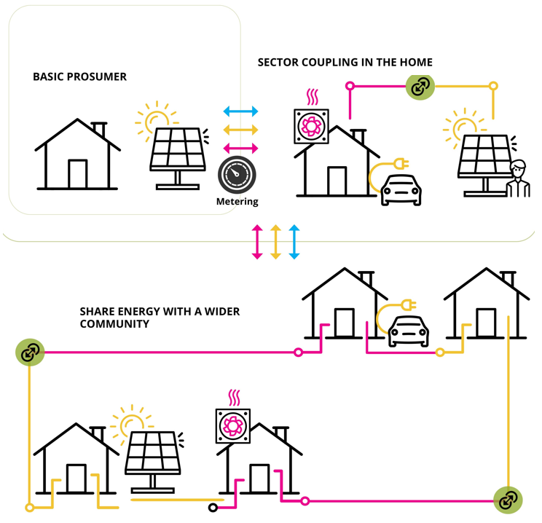
Unlike in the Republic of Srpska, the legal framework for net metering in the Federation of Bosnia and Herzegovina has been established yet
It is possible to produce electricity solely for one’s consumption
Engagement of Local Authorities
Civic energy projects
Source: CORDIS EU, European Comission

Slide 8
Virtual Power Plants
Agrovoltaics
Special lending conditions
Consulting

Slide 9
Panel II Business and Private Sector Initiatives Driving Energy Sector Reform Coming up…

