Slide 1
INTEGRATED ENERGY AND CLIMATE PLAN OF BOSNIA AND HERZEGOVINA
Dr. Admir Softić
Assistant Minister for Energy Sector
Ministry of Foreign Trade and Economic Relations BiH

Slide 2
"Energy and climate" in the EU and Bosnia and Herzegovina
Regulation (EU) 2018 / 1999
NECP
Decarbonization of the economy
Energy Community Treaty
Paris Agreement (NDC)
Clean energy package for all Europeans
Sofia Declaration for the Western Balkans

Slide 3
What is NECP and who is responsible for drafting it
What is NECP?
A medium-term plan describing how a country will contribute to achieving the net zero greenhouse gas emissions target by 2050 in Europe.
Realization of the NECP BiH objectives will contribute to decarbonization of the entire economy and thereby improve the competitiveness of the BiH economy in the European framework.
5 dimensions of NECP:
Decarbonization
Energy efficiency
Energy security
Internal energy market
Research, innovation and competitiveness
Responsible parties
Ministry of Foreign Trade and Economic Relations in BiH
Entity ministries in the field of energy and environment
Government of the Brcko District of BiH
with active technical support from:
Deutsche Gesellschaft für Internationale Zusammenarbeit (GIZ)
U.S. Agency for International Development Energy Sector Assistance Project (USAID EPA)
United Nations Development Program (UNDP)

Slide 4
Binding targets for Bosnia and Herzegovina by 2030
Greenhouse gas emissions (GHG) | Share of renewable energy sources | Energy efficiency - Primary energy consumption (PEC) | Energy efficiency - Final energy consumption (FEC)
15.65 MtCO2 | 43.62% | 6.84 Mtoe | 4.34 Mtoe
Greenhouse gas emissions (GHG) | Share of renewable energy sources | Energy efficiency - Primary energy consumption (PEC) | Energy efficiency - Final energy consumption (FEC)
15.65 MtCO2 | 43.62% | 6.50 Mtoe | 4.34 Mtoe
PEC objective is set more ambitiously than in the proposal by BiH

Slide 5
The binding target by 2030 – Greenhouse gases
Greenhouse gas emissions, including land use, land use change and forestry (LULUCF)
Total CO2eq emission with LULUCF in 2030 | 15.65 MtCO2
Reduction of emissions in 2030 compared to 1990 with LULUCF | 41.21%

Slide 6
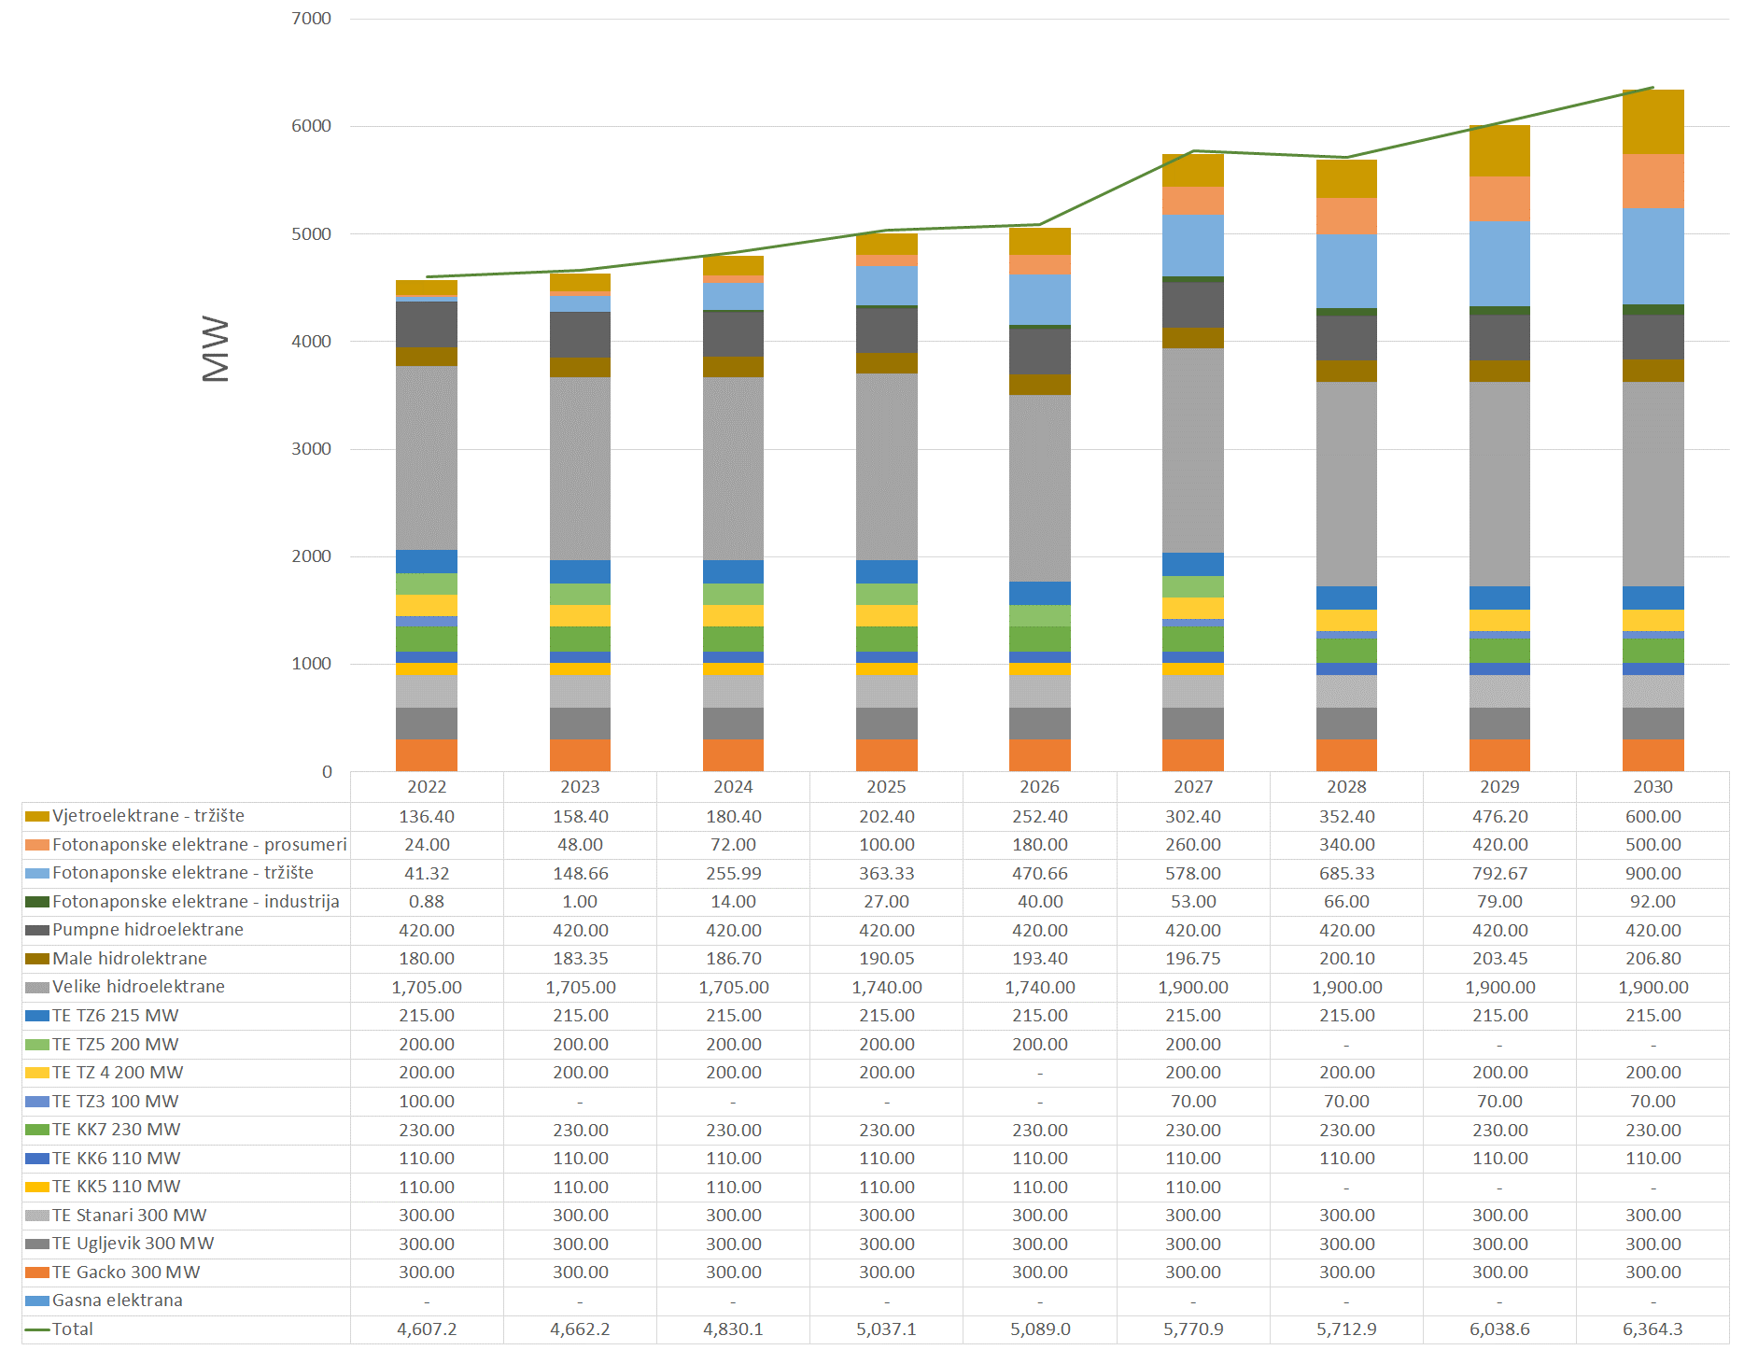
New power generation facilities until 2030.
Thermal power plants:
Decommissioning of 410 MW.
No new fossil fuel power plants.
Converting individual blocks to biomass.
Renewable energy sources:
Commissioning of over 2,000 MW on renewable sources.
The largest increase in photovoltaic power plants of over 1,500 MW.

Slide 7
Key policies and measures until 2030
Reduction of GHG emissions
Increased share of renewable sources
Increased energy efficiency measures
Adoption of the necessary legal framework and strategic documents
Establishment of an organized electricity and natural gas market
Establishment of greenhouse gas emissions trading schemes (EU ETS)
Establishment of the Guarantee of Origin system
Implementation of a just transition in coal regions
Rationalization of administrative procedures
Increased flexibility of the system and infrastructure
Intensified research and strengthened competitiveness
etc.

Slide 8
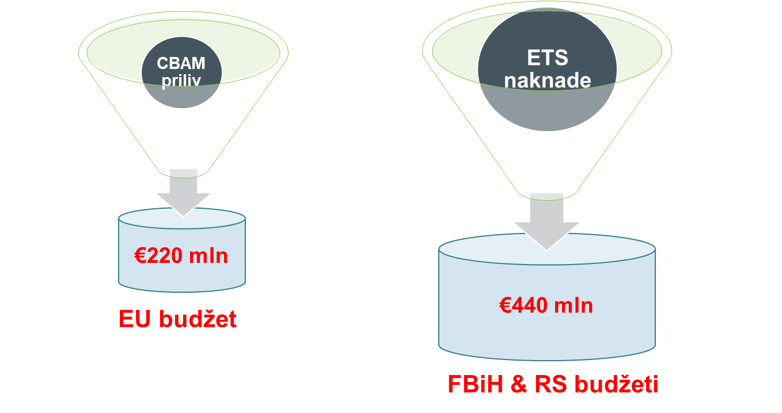
Establishment of a GHG emissions trading system (ETS)
CBAM vs. ETS
Electricity
Calculation done for the
CO2 price of 50 EUR/ton
ASSUMPTIONS:
Annual report: 3,400 GWh (20% of BiH coal-based generation)
The emission factor for BiH is 1,195 tCO2/MWh
Sources: EU4Energy Bosnia and Herzegovina

Slide 9
Investment estimate by 2030
Item | Rationale | Investment estimate (€)
Coal-based power generation | Reconstruction and transition to biomass | EUR 390.4 million
Coal-based power generation | Building new capacities | EUR 539.5- 539.5 million
Wind-based power generation | Building new capacities | EUR 529-635 million
Solar photovoltaic power generation | Building new capacities | EUR 719-874 million
Development of the electricity transmission network | New interconnecting transmission lines, New TS and transmission lines, Reconstruction and rehabilitation of plants, Installation of chokes | EUR 353.2 million
Development of the electricity distribution network | Realization of plans to expand the electricity distribution network | EUR 830 million
Fossil fuel district heating systems | Building new capacities | EUR 50 million
Biomass-fueled district heating systems | Building new capacities | EUR 51.1 million
Infrastructure for transportation and storage of natural gas | Construction of a new interconnection for natural gas transportation, Construction of natural gas storage capacity | EUR 490 million
Building renovation strategy | Increasing the energy characteristics of the envelope and technical systems of buildings | EUR 1050 million
Industry | Increasing the energy efficiency of industrial processes | EUR 665 million
Transport infrastructure | Infrastructure of charging stations for electric cars, Intensifying rail transport | EUR 275 million
Costs of a just transition | Mine closure, land rehabilitation, other socio-economic issues | EUR 465-1,395 million
Forestry |  | EUR 10 million
Human health |  | EUR 7 million
BAM 13.5 billion to 16 billion

Slide 10
Coming up: PANEL I - Energy sector in Bosnia and Herzegovina: Between energy transition and crisis

