Slide 1
Cyber Security in the Energy Sector
ILIJANA VAVAN

Slide 2
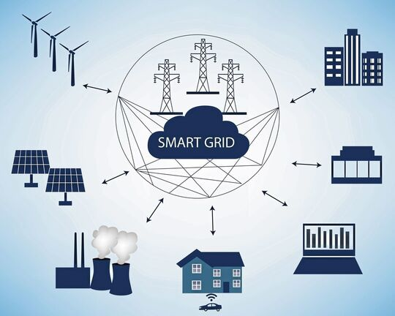
We live in the digital world

Slide 3
Conventional versus Smart Grid Model
Alternators
Transformers
Transmission lines
Generation
Transmission
Distribution
Consumption
Gen.
Control Block
Smart Meter
Consumer
Intelligent Sensors and Controllers
Automated Switches and Substations
Strong Communication and other technology
Power
Information
Controller

Slide 4
Digitalisation Challenges
Increased use of information and smart technology is opening the door to cyber criminals
Digitalisation brings together operation and information technology allowing attackers to exploit weak points in one before migrating to the other
SCADA (Supervisory Control And Data Acquision) hardware not designed with security in mind and is very vulnerable
IoT and AI increase exposure and potential vulnerabilities

Slide 5
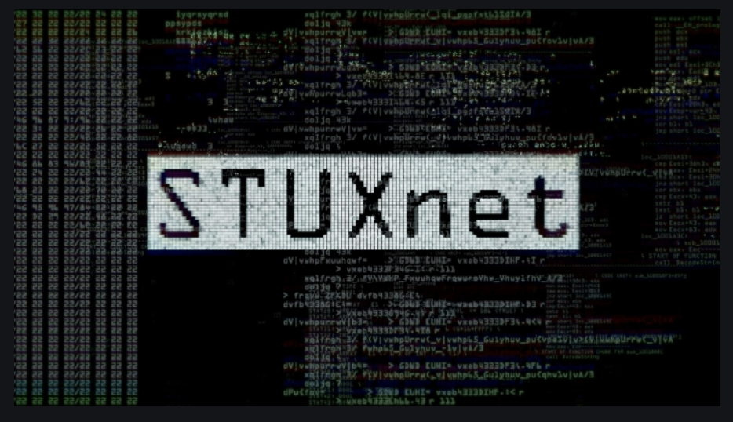
Attacks on Critical Infrastructure
2015 Attack on PCC in W. Ukraine leaving 230.000 people without electricity
The PCC operated SCADA
Attackers overwrote firmware on 16 devices leaving them unresponsive
Computer virus which spread in 2010 created by USA and Israel against Iranian nuclear plants
It looks specifically for a PLC of Siemens
Reads and changes particular bits of data in the controlled PLC
Reads and changes particular bits of data in the controlled PLC

Slide 6
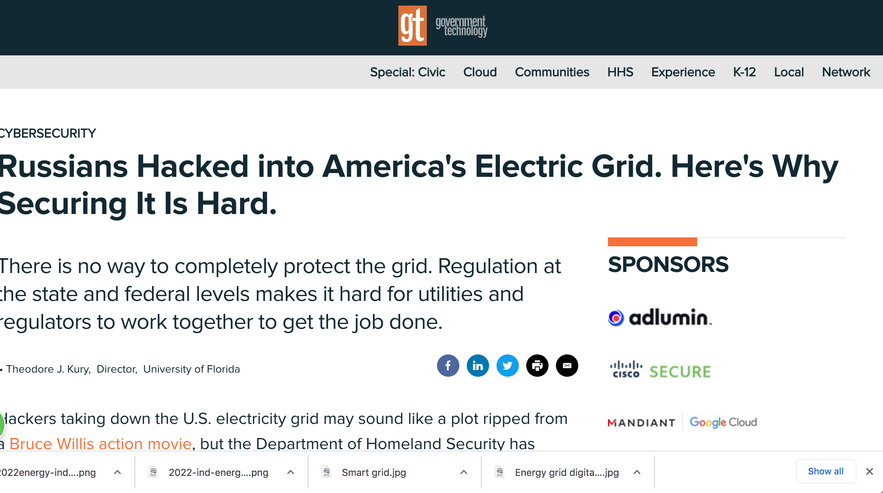
Attacks on Critical Infrastructure

Slide 7
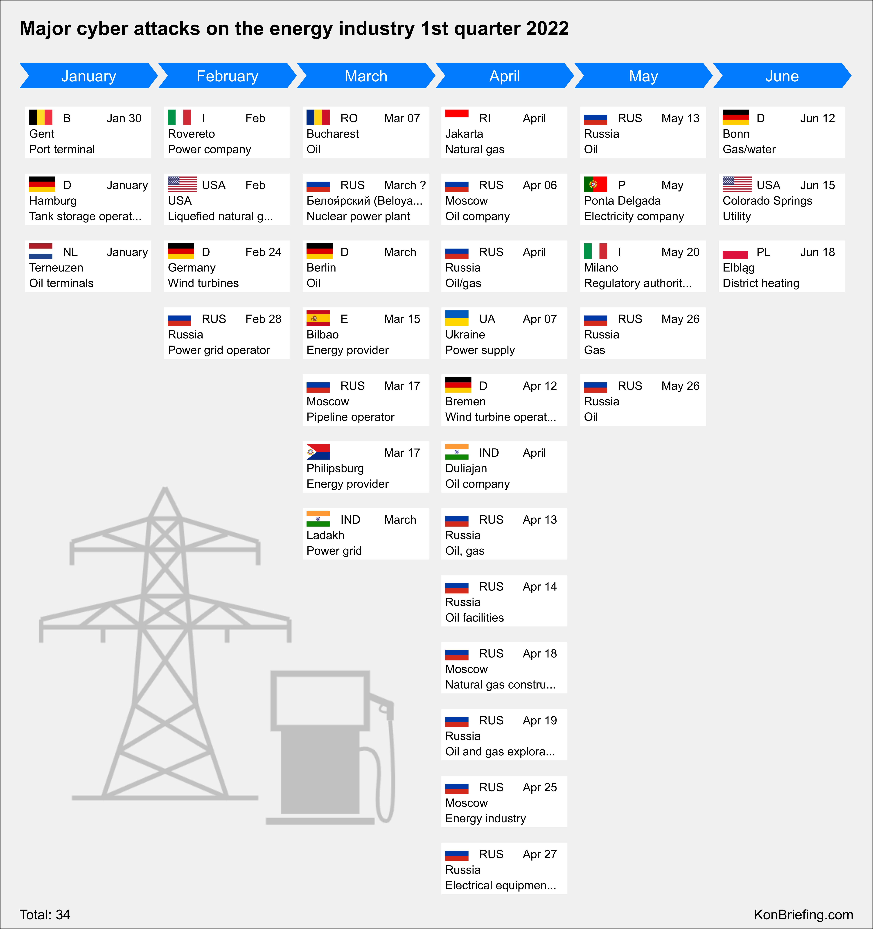
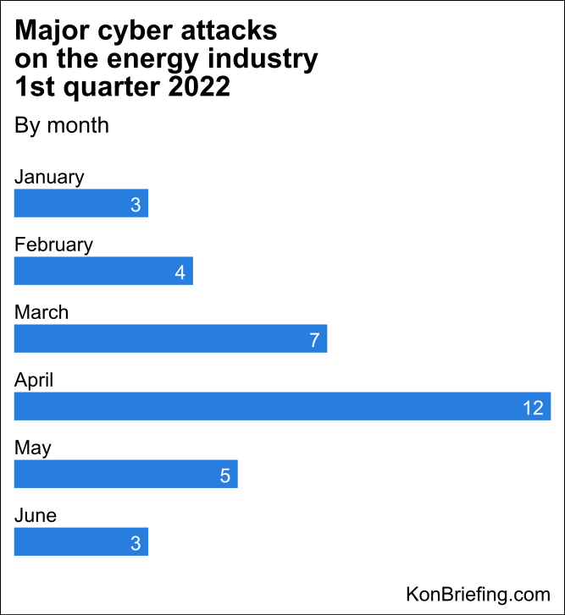
Attacks on Critical Infrastructure – 1st quarter 22

Slide 8
Costs of Cyber Attacks on Energy Sector
Nations wide Blackouts
6 hours blackout in France could cost 1.5B€
Avarage cost of a breach is $4.65M
Wellbeing of millions of people attacked
Loss of lives
Natural disasters

Slide 9
Nature of Attacks
Mostly human error
Phishing
Ransomware
Spyware
Man in the middle attack
IoT attacks
DDoS Attacks
USB sticks risks

Slide 10
Cyber attacks are here to stay
Energy is the top target to cyber attacks
Human error is responsible for 95% of all breaches
Supply chain target increased
Need more legislative and compliance efforts
Continuousely monitor, collect cyber data, leverage AI based cyber security
Implement CERTs
Implement End-to-End cyber security

Slide 11
THANK YOU

