Slide 1
BOSNIA AND HERZEGOVINA’S COMMITMENTS STEMMING FROM THE EU ACQUIS COMMUNAUTAIRE
Edin Zametica, MSc Secretary State Electricity Regulatory Commission

Slide 2
Commitment/Policy (in) BIH
Euro-Atlantic integration
Energy sector – leading the way
International agreements
Energy Charter Treaty
Treaty establishing the Energy Community (EU directives and regulations)
Stabilisation and Association Agreement
Paris Agreement on climate change
Berlin process
Sofia Declaration on the Green Agenda for the Western Balkans
(Alignment of the countries in region with the European Green Deal)

Slide 3
Energy Sector – Goals
Security and quality of supply
Acceptable prices
Appropriate use of potentials
Sustainable development – environment protection
Clear regulatory framework
Investments
Economically sound sector development
Efficient competitive single energy market
QoS
€

Slide 4
Energy Sector Complexity
Unsustainability of isolated supply systems
Common rules of connected systems
Complex system – aligned technical rules, legal norms, and economic conditions
Correlation with other sectors in economy
Interdependency of the energy subsectors
Multidimensional and layered sector
EU approach – evolution of the acquis communautaire: new regulations and directives

Slide 5
1st Energy Package (EU 1996 ⇨ 1999)
2nd Energy Package (EU 2003 ⇨ 2004) EnC 2006 ⇨ July 2007
3rd Energy Package (EU 2009 ⇨ 2011) EnC 2011 ⇨ Jan 2015 (excluding network codes and guidelines)
Clean Energy Package (EU2018 ⇨ 2020) EnC 2021 ⇨ Dec 2023 (including network codes and guidelines)
Market opening
Partial
100%
3rd Party access
Negotiated/Regulated
Regulated
Unbundling
Accounting
Legal and functional
Effective
Regulatory functions
No regulator
NRAs creation
Wider NRAs role +ACER+ENTSO-E+ENTSO-G
Wider ACER role
System operation
Independent TSOs
TSOs and DSOs
TSO Certification network codes/guidelines
Risk preparedness
Energy efficiency and renewables
2030 targets +RES integrat. cross border + EE buildings
Governance
NECP
Consumers
Consumer protection
Better information, protected, empowered
Competitive electricity markets
Strength short-term markets + regional cooperation + level playing field of sources

Slide 6
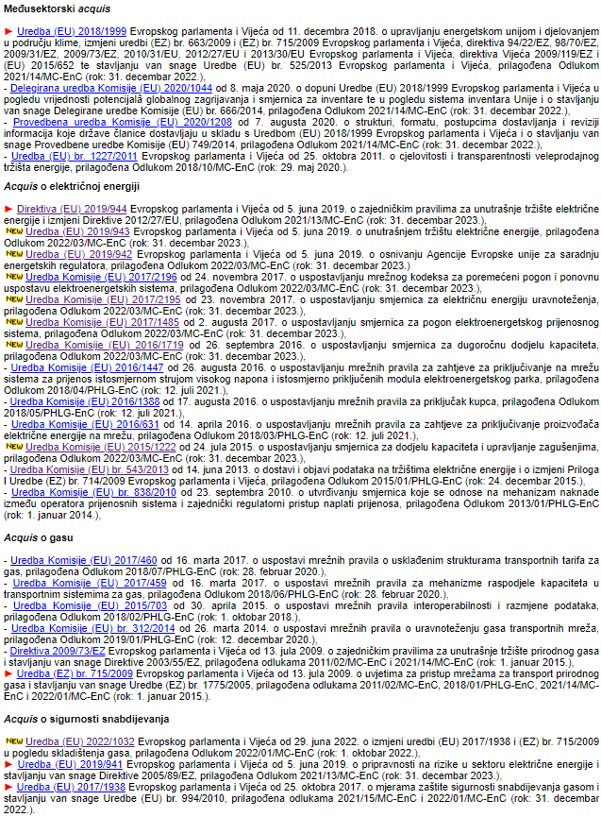
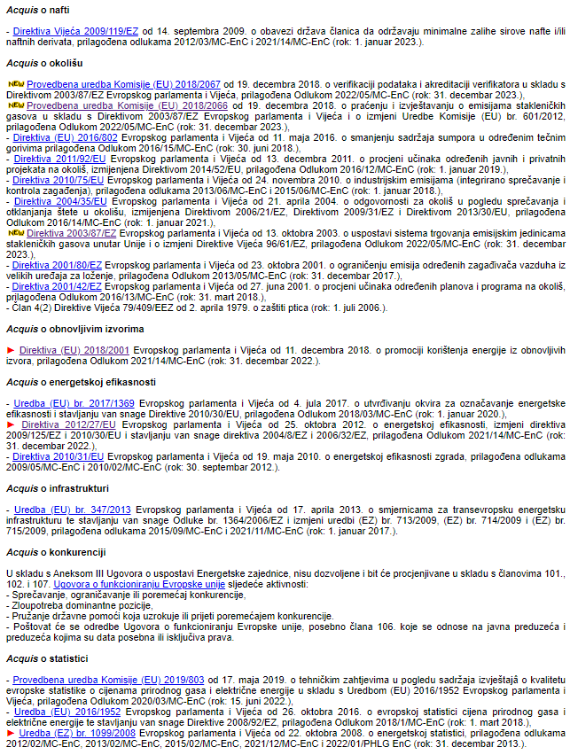
Commitments of BIH (Stemming from the EnC)
Transpose and implement the current EnC acquis:
Cross-cutting acquis (4R)
Electricity (1D+12R)
Gas (1D+5R)
Security of supply (3R)
Oil (1D)
Environment (8D+2R)
Renewables (1D)
Energy efficiency (2D+1R+...)
Infrastructure (1R)
Competition (4 articles of EU Treaty)
Statistics (3R)
www.derk.ba/en/legislation/acquis-energetske-zajednice
Notes:
R – Regulations
D – Directives

Slide 7
Network Codes and Guidelines
CYBERSECURITY
SISTEM OPERATION
NCCS Network Code on Cybersecurity*
SO System Operations
ER Emergency and Restoration
IMPLEMENTATION
GRID CONNECTION
160+ Terms and Conditions or Methodologies
RfG Requirements for Generators
DCC Demand Connection Code
HVDC High Voltage Direct Current
MARKET CODES
CACM Capacity Allocation and Congestion Management
FCA Forward Capacity Allocation
EB Electricity Balancing
* The adoption of NCCS is ongoing in EU
** Activities initiated to prepare the Guidelines on Demand Response
Notes:
The European market rules establish obligations for Transmission System Operators (TSOs), Nominated Electricity Market Operators (NEMOs), the European Network of Transmission System Operators (ENTSO-E), regulatory authorities and ACER on the development and approval of terms and conditions or methodologies.

Slide 8
EnC Secretariat Annual Report
Transmission system operator (TSO) is not unbundled (in line with the provisions of the Third Package), no legal basis for TSO certification
Legal framework does not define an organized wholesale (spot) market nor designation process for nominated electricity market operators (for the day-ahead trading and intraday trading)
Legal basis for unbundling of DSOs is in place only in RS
Regulation (EU) 347/2013 on guidelines for trans-European energy infra-structure was not transposed (will be repealed by Regulation 2022/869)
Regulator’s institutional framework does not comply with acquis
(...)
Vienna, 1 November 2022
Notes:
Annual Implementation Report of the Energy Community Secretariat 2022

Slide 9
EU 2022 Report on BIH
“In the coming year, Bosnia and Herzegovina should in particular:
Adopt gas and electricity laws and bylaws, in compliance with the third energy package, at state and entity levels and ensure the full harmonisation of laws at entity level in the area of electricity and gas to prevent further delays in opening and functional operating of the energy market and establishment of a day-ahead electricity market.
Adopt state- and entity-level legislation on renewable energy and energy efficiency in line with the obligations stemming from the Energy Community Treaty and the commitments from the 2020 Sofia summit declaration on the Green Agenda for the Western Balkans.
Sign a direct agreement with the service provider to use electronic registers for issuance, cancellation and trade of guarantees of origin.
Finalise and adopt the national energy and climate plan (NECP) 2021-2030”
Brussels, 12 October 2022 (page 100)

Slide 10
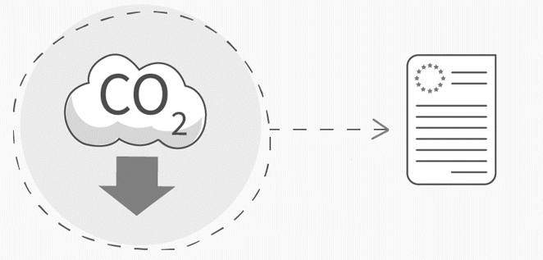
New Commitments – Electricity
Clean Energy for all Europeans package – completed/included in EnC acquis
Network codes and guidelines – completed/included in EnC acquis
Procedural Act on Regional Market Integration adopted – active role of ACER and ENTSO-E in the Energy Community
Consumer rights: smart meters, dynamic pricing, upgraded comparison tools, active consumers, more than one supply contract, supplier switching within 24 hours (by no later than 2026), ...
(...)
Ongoing activities on Fit for 55 package – set of proposals to revise and update EU legislation

Slide 11
Concluding Notes
Global energy crisis – importance of just energy transition
(Accelerated) Energy legislation alignment with the EU and Energy Community acquis required (+implementation!)
Innovate strategic documents
Far-reaching consequences of non-compliance

Slide 12
Concluding Notes
Importance of transparency and participation of citizens and all stakeholders in the creation of the legal framework and strategic documents
The acquis continues to develop – ensure timely transposition
Candidate status of Bosnia and Herzegovina – additional momentum for the necessary changes

Slide 13
Thank you for your attention!
ezametica@derk.ba
www.derk.ba

