Slide 1
Just Transition in coal regions of Bosnia and Herzegovina
Just Transition Road Map – The World Bank Draft
Neum, April 27, 2023

Slide 2
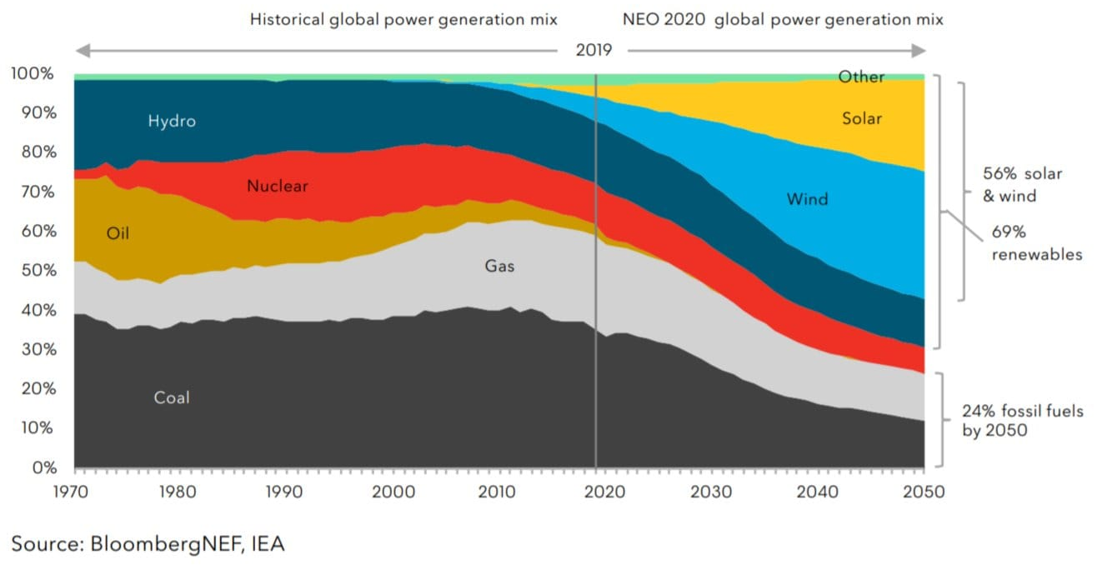
A global perspective – the transition is already happening…

Slide 3
Scope of the Technical Assistance
Institutional governance
People and communities
Land and environmental remediation
Assess the workforce affected by the transition with a view to managing reallocation and reskilling of workers
Complete an extensive stakeholder mapping exercise with recommendations on a stakeholder engagement strategy
Review legislation regarding land repurposing and spatial planning
Provide recommendations to the authorities on a governance structure for transition
Provide preliminary recommendations on social protection and active market labor policies for direct and indirect workers
Apply the land use repurposing application to some mine and TPP pilot areas
Complete analysis on opportunities for power and district heating sector transition considering the NECP
Develop strategic land repurposing planning framework
Twinning program between BiH, USA and Greek coal stakeholders, supported by the Western Balkans and Ukraine Coal Regions in Transition Platform Initiative

Slide 4
Stakeholder Engagement
Methodology:
Online and face-to-face consultations
81 government and non-state groups
20 meetings
132 stakeholders
Public perception survey (WB)
1,625 respondents from 11 coal regions
176 respondents in control group
Varying degrees of knowledge & awareness on Just Transition: government stakeholders at State and Entity level are very aware of international and BiH commitments. But 80 percent of coal region respondents do not feel informed on Just Transition concepts and policies.
Stakeholders wish to be involved in planning for a Just Transition: 76 percent of respondents in the perception survey indicated need for coal region populations to be involved in decision-making for transition
Transparency through early communication was noted as necessary: majority of those consulted felt information needed to be communicated early on (i) the number of jobs that will be lost and number of jobs that will be created; and (ii) costs to households of switching to renewable energy. These findings correlated with top two concerns of respondents in the perception survey (job losses and electricity price increases)

Slide 5
Governance for Transition
Methodology:
Online and face-to-face consultations
81 government and non-state groups
20 meetings
132 stakeholders
Public perception survey (WB)
1,625 respondents from 11 coal regions
176 respondents in control group
Need for high-level political decision-making: overall transition strategy should be developed at high level, but with cantonal and municipal authorities playing an important role.
Hybrid governance model proposed by stakeholders: coal transition governance structure to involve various levels of government with affected stakeholders also present.
Structure responsibilities to include: (i) Strategic planning and knowledge sharing; (ii) Inter-entity coordination; (iii) Funding-raising and financing; (iv) Technical expertise on jobs, community development, and land asset management and repurposing; (v) Transition project management; and (vi) Stakeholder engagement

Slide 6
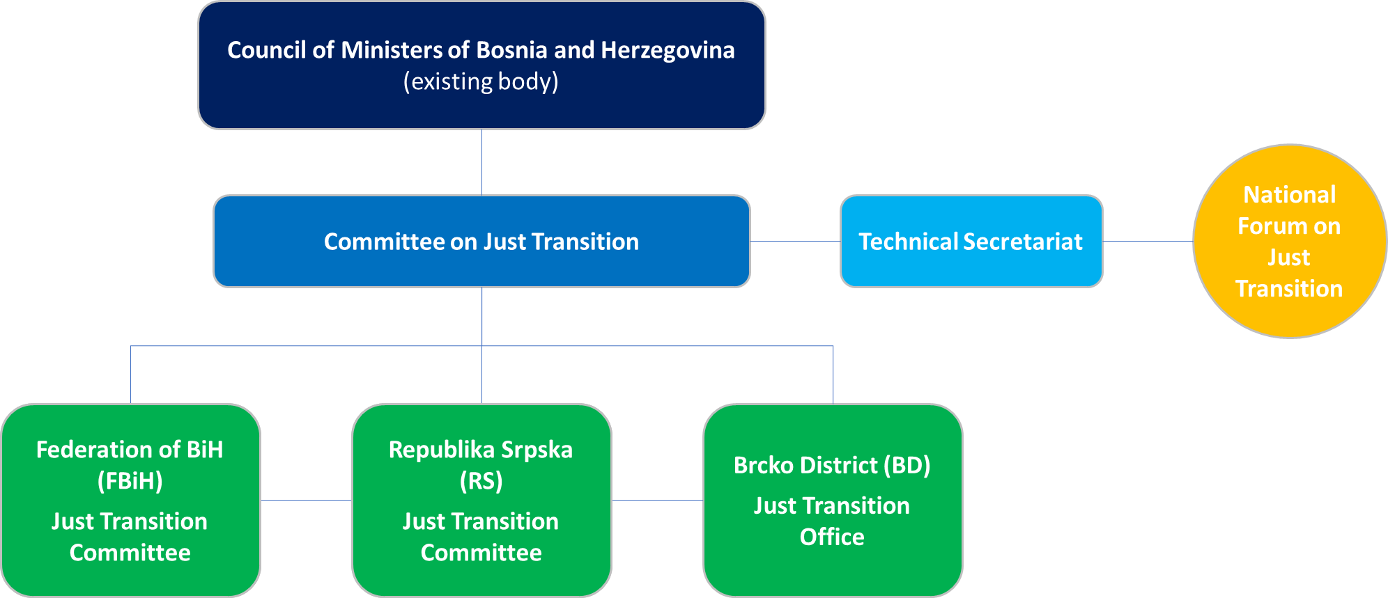
Proposed Governance Model Option: State Level

Slide 7
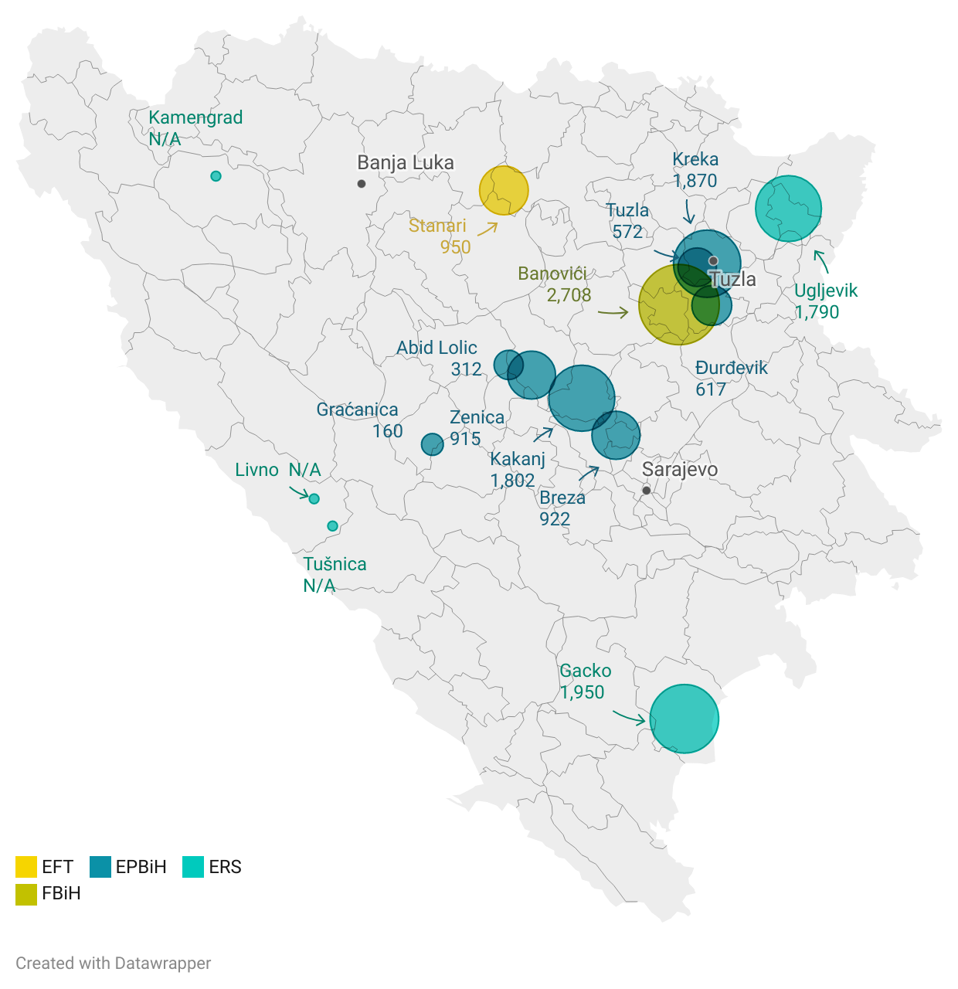
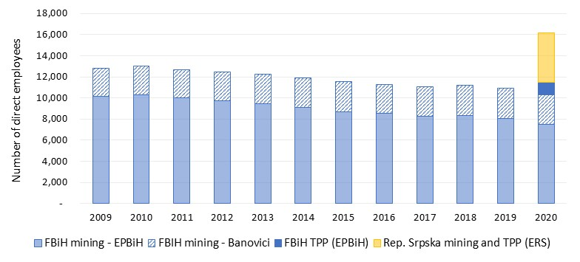
Number of direct coal sector jobs: 9,700 in FBiH, 4,700 in RS

Slide 8
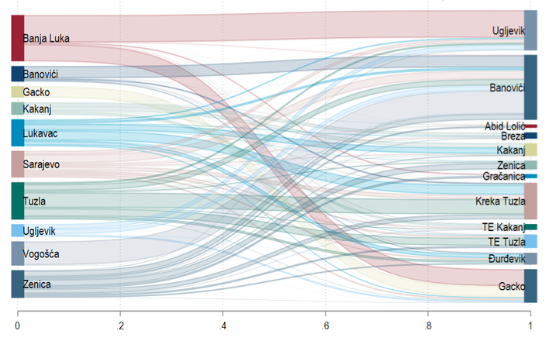
Indirect jobs in coal value chain
1.900-2.400 indirect jobs
Most contract value is spatially concentrated in urban centers (Banja Luka, Sarajevo) or close to extraction sites
Most suppliers that are dependent on coal-sector contracts are small, and contract with 1-2 mines/power plants.

Slide 9
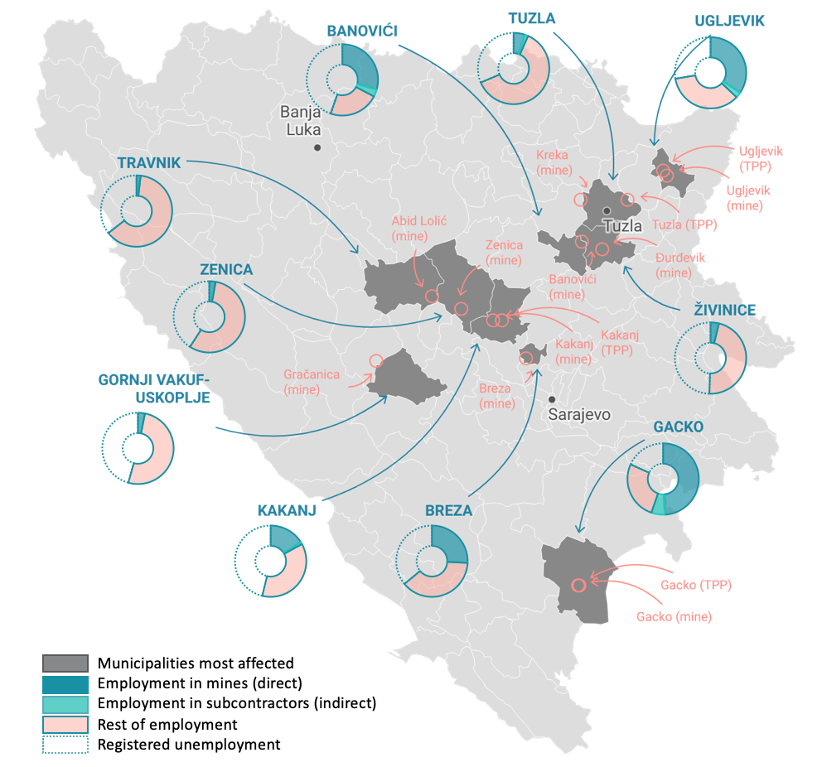
Coal-related employment is dominant in relatively few municipalities
Vulnerable to economic fall-out from mine closure due to:
dependence on coal activity
already high unemployment
Indirect job estimates exclude those employed in local private firms that are also likely to lose business under coal phase-down

Slide 10
Next Steps
Characterize coal worker profiles (occupation, skills, preferences)
→ Information from mine & TPP operators, survey tools
Measure other “indirect” jobs (how many, skills, preferences)
→ HH surveys, SME surveys, unemployed
Assess potential transition pathways based on existing jobs in labor market
Review Social Protection & ALMP policy opportunities and gaps for supporting the transition of affected workers
Design menu of policy options, method of tailoring packages

Slide 11
Overview of Legislative and Regulatory Review
The legal analysis included a review of mining laws in each entity and regulations governing mine closure, land reclamation and repurposing, as well as related ancillary laws and procedures on agriculture, urban and spatial planning, environment, etc.
Mine closure and post-mining lands reclamation are governed by several government levels and branches.
Standards for post-mining land reclamation and remediation are detailed in existing regulations in both entities. FMERI in FBiH is the key institution, in RS it is MEIR.
Exact legal procedures for repurposing lands depend on the type of land and the proposed repurposing type. Depending on these types, inputs from various sectors may be required (i.e. – agricultural permits, urban consent, ESIAs and/or environmental permit).
Permitting procedures are lengthy and require spatial plans to be changed due to land use changes – this adds to the complexity and length of time required.

Slide 12
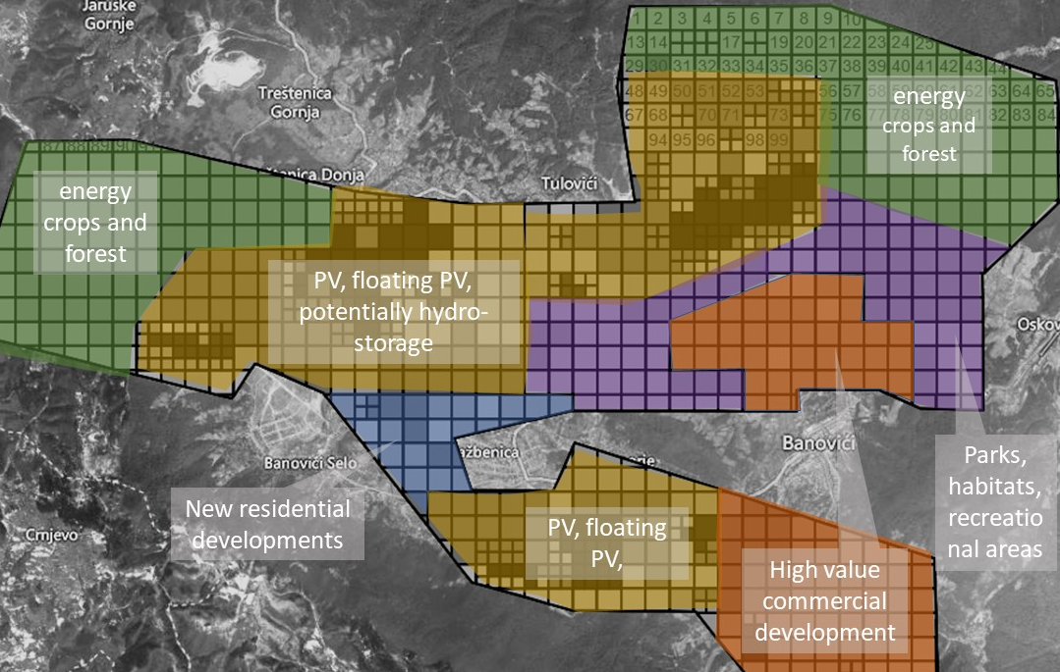
LURA at the Banovici Coal Mine
The Banovici mine was evaluated along 5 criteria (environmental risks, geotechnical situation, location, topography and hydrography, potential added land value). LURA results show lands are best suited for:
Business, recreation and tourism, including potential residential areas (35%)
Agricultural lands, forests, energy crops (31%)
Industry and energy production – e.g., space for PV (21%)
The rest will be residual ponds and lakes.

Slide 13
Recommended Policy Actions
Create an enabling environment for investment in post-mining lands by designating post-mining lands as “special zones” and introduce legal, regulatory and financial incentives for attracting investment in these zones.
Enact new regulations in the form of a “special procedure” to create streamlined conditions for permitting in these special zones. Establishing a Special Purpose Entity (SPE) would also facilitate the streamlining of permitting and coordination of all stages of the mining transition. Combine this with the drafting of a “Special Spatial Plan”, which would allow pre-classification of certain land parcels as suitable for defined uses, e.g. RE, industrial / commercial areas, or energy crop plantations.
Establish a national database of soon-to-be-available brownfields, complete with relevant data and geospatial information, to direct investments towards these areas.
Develop a national policy that sets out a clear direction for optimal land reclamation and repurposing in line with BiH plans for a clean energy transition.

Slide 14
Alternative energy pathways – generation expansion planning
The objectives:
Perform assessment of necessary investments in BiH power sector for the period 2023-2050
Estimate the costs to expand and operate the power system, considering international commitments, Energy Community policies/objectives, RE targets, CO₂ reduction targets, introduction of carbon pricing schemes, etc.
Simulate system operation and calculate key operational metrics (dispatch of generation and reserves, VRE penetration/curtailment, benefits of energy storage, security of supply, etc.)
Through the current analysis, support the ongoing development of the NECP
Looking at:
The options associated with re-purposing each of the existing power plants and mines:
Fuel switching: existing coal plants may be converted to burn natural gas or biomass
Renewable installations: use the plant and mine lands to install RE plants (solar PV, wind and biomass)
Utilization of existing coal plant generators: as synchronous condensers (SYNCON) for voltage control and BESS
The power system options which can be deployed anywhere in the system and are needed to satisfy the demand

Slide 15
Alternative energy pathways – the scenarios and main results
 | Baseline | Decarbonization | Energy Security
Key features | 0.75% demand growth | stringent CO₂ targets | reliance on domestic energy sources
Total generation (GWh) | 563,582 | 516,017 | 537,895
Total demand (GWh) | 410,631 | 410,631 | 410,631
Total capacity added (MW) | 5,028 | 4,656 | 6,162
Total investment (USD million) | 6,557 | 5,867 | 7,509
Import costs (USD million) | 2,540 | 3,690 | 2,299
Export revenue (USD million) | 13,315 | 11,682 | 12,808
NPV of system cost (USD million) | 4,776 | 4,237 | 4,595

Slide 16
Energy security scenario – capacity plan

Slide 17
Energy security scenario – generation mix

Slide 18
Alternative energy pathways – coal consumption

Slide 19
Alternative energy pathways – CO2 emissions

Slide 20
Alternative energy pathways – RE share

Slide 21
Main takeaways
Transition to clean energy sources makes economic sense for BiH, considering the age of existing coal-fired assets, substantial decline of renewable costs and the introduction of carbon prices.
BiH’s long-term energy mix can make strategic use of BiH’s natural resources. Coal is being replaced by a mix of hydropower, wind, solar and, potentially, biomass.
Driven by CO₂ prices, operation of coal-fired plants gradually becomes uneconomical in all scenarios between 2030-2035. Post 2035, operation of all coal plants in BiH either completely stops or they continue operating at very low capacity factors.
Both wind and solar PV are part of the optimum generation mix; wind estimations range from 2,390-3,180 MW, while solar PV reaches up to 1,780 MW, depending on a scenario.
Hydropower is a strategically important option for BiH and needs to be developed. Storage hydro is particularly competitive in the case of Energy Security, when firm capacity and balancing needs should be satisfied from domestic sources.

Slide 22
Main takeaways
Biomass requires further evaluation to determine its competitiveness. The option of growing energy crops in reclaimed mining areas is attractive but the production costs and their economics are uncertain.
No new coal and natural gas plants are selected as part of the optimum generation mix.
BiH remains a net exporter of power in all scenarios; it imports as necessary, but it exports more. The costs of the power sector transition can be off-set, in part, by BiH’s energy trade position in the region.
The CAPEX values required to meet the demand in BiH by 2050 range from USD 5.87 billion in Decarbonization to USD 7.51 billion in the Energy Security scenario.
Energy security requires significantly higher new capacity, but results in security of energy supply, while maintaining the benefits from regional trade. This is achieved at a very low increase of system costs and USD 1.6 billion additional investment comparing to Decarbonization scenario.

Slide 23
Roadmap for transition – short-term Actions (before 2030)
Coal
plants
Finalize selection of coal units to retire
Coal
mines
Repurpose 1-2 mining areas with large renewables, considering other uses
Restructure coal mines
Optimize emission controls
Reforms
RE and other energy
Deploy renewables at coal plants and mines and elsewhere, as appropriate
Accelerate development of hydropower plants as a priority
Biomass / energy crops
Develop pilot energy crops and initiate cofiring in 1-2 units
Evaluate economics in more detail
Decide if 1-2 power plants should be converted to biomass
Plan development of energy crops as appropriate
Set retirement time, plan unit closure activities and build capacity
Analyze deployment of REs, BESS and SYNCONs
Secure support by private investors
Undertake regulatory and legal reforms to support deployment of REs
Support development of the wholesale power market
Build capacity
Transform power utilities (e.g., restructuring)
Enable large-scale private sector participation
Consider deployment of pumped-storage (e.g., closed-loop; abandoned mines)

Slide 24
Roadmap for transition – medium-term Actions (2030-2040)
Coal
plants
Accelerate closure of coal plants
Coal
mines
Repurpose remaining large scale mining areas using REs and other uses
Other
RE and other energy
Continue large-scale deployment of renewables throughout the country
Continue and scale up development of hydropower plants
Biomass / energy crops
Implement 1-2 biomass power projects, if proven cost-effective
Develop required energy crops in parallel
Repurpose them with solar PV, SYNCON and BESS, as appropriate
At scale, deploy other technologies (e.g., BESS, EVs, etc.)
Develop utilities of the future
Consider other uses at coal plant assets (e.g., business, industry, etc.)
Explore options to attract industry to strengthen employment
Critical to ensure involvement of private investors (e.g., PPPs)
Strengthen the grid, as appropriate

Slide 25
Concluding Remarks
BiH is in a unique position to fully decarbonize its power sector by replacing her coal-fired assets with clean RE technologies, retain its energy independence by meeting its internal demand, remain the leading electricity exporter in the region, and timely meet its international commitments at the same time.
All key stakeholders need to agree on the way forward and support the energy transition.
All options have their pros and cons! There are no perfect options.
Compromises would be needed throughout!

Slide 26
THANK YOU
rperks@worldbank.org
dmalovic@worldbank.org

